Slide 1
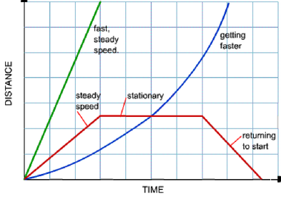
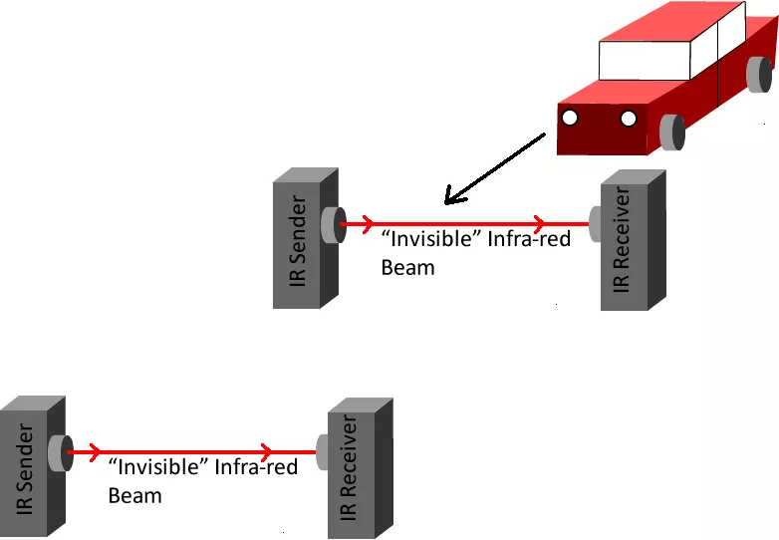
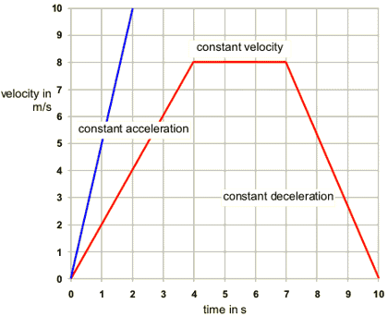
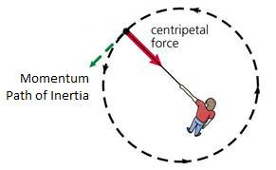
Topics 2 & 3: Motion, Forces & Energy
v = d / t | velocity = displacement ÷ time
 | speed = distance ÷ time
a = (v - u) / t | acceleration = change in velocity ÷ time
v² - u² = 2 a s | (final velocity)² – (initial velocity)² = 2 × acceleration x distance
F = m a | force = mass × acceleration
W = m g | weight = mass × gravitational field strength
ρ = m v | momentum = mass × velocity
F = m v / t | force = change in momentum ÷ time
G.P.E. = m g h | change in gravitational potential energy = mass × gravitational field strength × change in vertical height
K.E. = ½ m v² | kinetic energy = ½ × mass × velocity²
efficiency = (useful energy transferred by the device) ÷ (total energy supplied to the device)
Scalar quantities only have a magnitude (a number part). For example an energy of 30 Joules
Vector quantities have a magnitude and a direction. For example a velocity of 3m/s east
Scalars | Vectors
Distance Speed Mass Energy | Displacement Velocity Acceleration Force Weight Momentum
The 10 formulae to the right must be memorised. Some of them can be made by combining others if you know how to substitute and rearrange
We often use a stopwatch to find the time a moving object takes to go a known distance. We can also use light-gates which are more precise
The formula F = ma comes from Newton’s second law of motion. You are expected to know Newton’s 3 laws of motion.
1. Every object persists in its state of rest or uniform motion in a straight line unless it is compelled to change that state by forces impressed on it.
2. Force is equal to the change in momentum per change in time. For a constant mass, force equals mass times acceleration.
3. For every action, there is an equal and opposite re-action.
You are expected to know the typical speeds of several things which are listed below. To convert from mph into m/s you can divide by 2.25.
Item | Speed
Walking Running Wind (calm day) Cycling Vehicles Train Plane Sound (in air) Light (in air) | 1.5 m/s 3 m/s 5 m/s 6 m/s 15-30 m/s 50 m/s 250 m/s 340 m/s 3x10⁸ m/s
The gradient of a distance-time graph shows the speed
Momentum depends on mass and velocity. A small mass travelling very fast (like a bullet) and a big moving mass (like a walking elephant) both have a lot of momentum. They would both take a lot of stopping.
Newton’s third law is also related to momentum because the total momentum is conserved in collisions between objects (i.e. there is the same amount of it after as before)
An object travelling in a circle must have a resultant force acting on it which causes it to change direction. This inward pointing force is called a centripetal force. For planets the centripetal force is a caused by gravity
You are also expected to estimate typical every day accelerations, for example…
Item | Acceleration
Gravity (Earth) Family Car Rollercoaster Fighter Jet Injuries | 10 m/s² 4 m/s² 40 m/s² 80 m/s² 200 m/s²
The gradient of a velocity-time graph shows the acceleration. The area under the graph shows the displacement
Any object travelling in a circle (e.g. a planet in orbit) at a constant speed has a changing velocity. The magnitude of the velocity doesn’t change but the direction does.

Slide 2
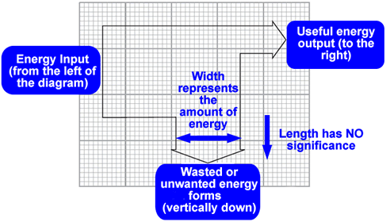
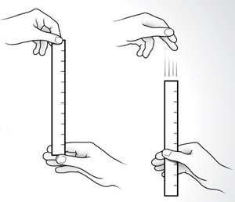
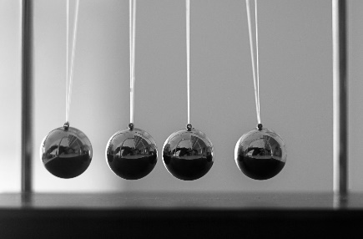
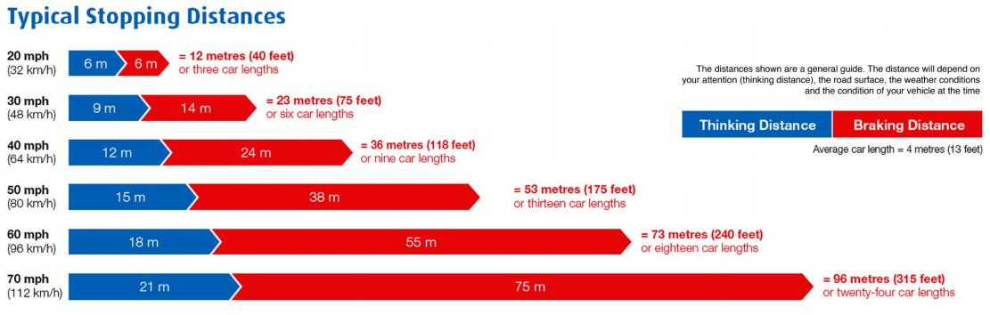

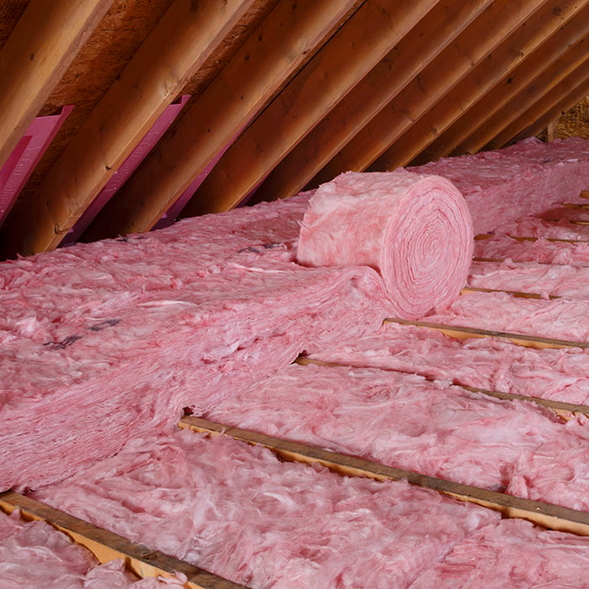
Topic 2: Motion & Forces (part 2)
Topic 3: Energy Conservation
The distance a vehicle travels before stopping (e.g. in an emergency) depends on 2 things - how far it goes before the driver presses the brakes, and how far it travels after they press the brakes.
We say that the stopping distance equals the thinking distance + the braking distance.
Energy cannot be created or destroyed, it is always conserved.
Energy can be transformed from one form into another. We represent this using a Sankey diagram (sometimes called an energy transfer diagram). (Also see topic 8)
There are several types of energy store:
magnetic
kinetic (movement energy)
thermal energy
gravitational potential
chemical
elastic potential
Nuclear
Energy is transferred by one of the following pathways:
1. By forces, 2. by electricity, 3. by heat, 4. by sound or 5. by light
A ruler drop experiment can be used to measure human reaction times. Our reaction times depend on several factors. The time is caused by the time needed for the nervous signals in the body to go from the eyes, to the brain, and then after processing by the brain, to the muscles.
There are other ways to measure reaction time – e.g. a computer activity where you are asked to react to an event on the screen by pressing a key.
Formulae for calculating kinetic energy and gravitational potential energy can be found on the other side of this sheet
As a pendulum swings downwards energy is transformed from gravitational potential into kinetic, and then as the ball rises at the other side the kinetic energy is transformed back into gravitational potential
In almost all energy transformations some energy is transformed to heat which escapes. We call the energy that is transformed to heat wasted energy, and we say that the energy transformation is not 100% efficient
The stopping distance of a car depends on many things including: the mass of the car, how fast it is travelling (see above), the reaction time of the driver, the condition of the road, the condition of the brakes, and the amount of friction between the tyre and the road.
Tiredness, intoxication (e.g. drugs and alcohol), and distractions (e.g. mobile phones) can affect the reaction time of a driver.
We use oil to provide lubrication of moving mechanical parts. This reduces the amount of unwanted energy transformation.
We also use insulation to reduce heat loss from buildings. We can increase the insulation of buildings by using better materials or thicker layers (e.g. thicker walls)
The energy that powers our lives, work and home comes from a range of sources. Some are renewable, some are not. Non-renewables include coal, oil and gas which we burn. Renewables include biofuels, wind power, hydropower, solar power and tidal power. We can also use nuclear fuels which are not renewable but have a long lifespan and don’t produce much carbon dioxide.
Energy for our homes costs money to supply. Supplies are not unlimited. We try to find ways to use less energy both to save ourselves money and to protect the environment.

