Slide 1
Organising and planning a fitness training programme
Week 17 Factors to consider

Slide 2
Learning outcomes
By the end of this week, you will know and understand:
aspects to consider when planning a fitness training programme
how links can be made to principles and goal setting

Slide 3
Starter activity
In pairs, write down five things that you feel may need to be taken into consideration before starting a fitness training programme.

Slide 4
Factors to consider
What are the participant’s fitness weaknesses?
What is the participant’s medical history?
Does the participant have any current injuries?
What are the aims of the programme?
What type of training should be used?
What goals does the participant hope to achieve?

Slide 5
Factors to consider
How long should the programme last?
What equipment (if any) is required?
How can the participant reflect on how training is going/has gone?
When should the participant retest their fitness to see if improvement has occurred?

Slide 6
Facilities and equipment
Appropriate facilities and equipment should be used to ensure that the training type(s) used are carried out correctly.
If facilities or equipment do not allow the training to follow the correct procedure, it can affect the performer’s ability to develop the component(s) of fitness that have been chosen.

Slide 7
Facilities and equipment
The correct weight should be chosen to work at a suitable intensity. If an incorrect intensity is chosen, then the muscular adaptations will be different to what is intended.

Slide 8
Facilities and equipment
The facility being used should have the space and suitable equipment to set up and perform a full circuit as part of a circuit training programme. If it does not, then some exercises that would help to achieve the desired goal may be missed.
A suitable pulse reader is needed if heart rate/pulse is being used, or the amount of overload being applied may be incorrect.

Slide 9
Safety/risk assessments
Safety should always be considered.
Part of assessing safety is to consider whether the participant is fit and able to carry out a training programme.
It is therefore advisable to take some simple information first, such as:
name and age (if the participant is not yourself)
weight
recent or current injuries
how accessible the facilities are.

Slide 10
Safety/risk assessments
Having recorded these basic details, it is then advisable to carry out a physical activity readiness questionnaire. A questionnaire is a series of questions to be answered truthfully.
The PAR-Q (physical activity readiness questionnaire) is a suitable starting point for determining whether the participant can increase the amount of physical training in their life (see next slide).

Slide 11
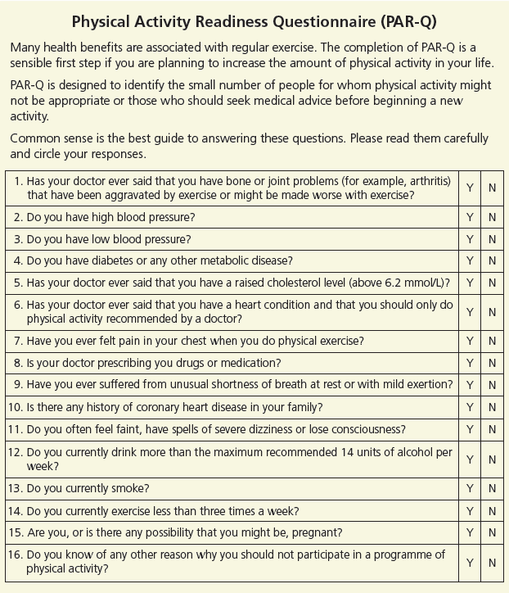
Safety/risk assessments

Slide 12
Safety/risk assessments
Risk assessment should be carried out as follows:
Step 1 Hazards | Step 2 Severity | Step 3 Residual risk rating | Step 4 People at risk | Step 5 Existing control measures
Identify significant hazards | State the severity of the hazard (high, medium, low) | State the probability of the hazard occurring (high, medium, low) | List the people who are at risk from the hazards you have identified | List what could be done to reduce risks. Note any action that you think is needed

Slide 13
Aims/goals/objectives
The aim or goal of the training programme is decided before starting and is recorded. This ensures that the overall objective is clear and that the focus on what is being improved remains a priority.
Remember goals should be SMART (specific, measurable, achievable, realistic, time-bound).

Slide 14
Example of aims/goals/objectives
To use continuous training over a six-week period to improve cardiovascular endurance for cross-country running. This will be tested via a pre- and post-multistage fitness test with the aim of improvement in the test score.
S goal is specific to cardiovascular endurance which is needed for cross-country running
M an improvement in the test score can be measured
A the six-week period demands any improvement so it is achievable
R the improvement of cardiovascular endurance in six weeks is realistic
T six weeks to complete.

Slide 15
Current fitness levels/injuries
Current levels of fitness should be considered. Initial fitness tests can be compared to normative averages and if the current level of fitness is very low, then the goals set should not be set too high.
If the performer has any current or recurring injuries, the training coach should know so that they can design a warm-up that will specifically help the vulnerable area of the body and can monitor for possible injury as the programme develops.

Slide 16
Current fitness levels/injuries
Injuries may mean that training needs to stop or that the intensity needs to be reduced.
The current fitness level should help you to make an appropriate plan, i.e. a good level of fitness will mean that the frequency, intensity and duration of training may be higher than for someone whose fitness level is low.

Slide 17
Organisation
Organise the use of facilities so that training can take place.
Organise equipment in advance of training, for example, ensure there are appropriate weights to lift, hurdles to jump over for plyometrics, check that the stopwatch is working correctly.
The equipment chosen should allow for some variation in training to prevent boredom from occurring.

Slide 18
Organisation
Some equipment may need to be set up in advance of the session starting, for example, any equipment needed for a circuit being placed at the point that the station will take place.
The equipment chosen should be suitable for the person using it, for example, weights that are not too heavy.
The equipment chosen should also be suitable for the activity being trained for, for example, exercises that work the muscles used in the activity.

Slide 19
Environment
An evaluation of the environment where the training is taking place should be undertaken. A range of pre-training checks may be required.
If continuous training is taking place in the natural environment, are all points of the route safe? For example, are they free from flooding or loose rocks?

Slide 20
Environment
Have weights been cleaned and sanitised prior to use and any spillages cleaned up in the weights gym?
Is a ‘spotter’ needed for the weight training? A spotter is another person who helps to lift the initial weight or helps put the weight back down, so that the person training does not suffer an injury.
If a treadmill is being used, has it been serviced and is it working properly?

Slide 21
Skills to be improved
When designing a fitness training programme, it is important to remember that the improvements in fitness should ideally also result in an improvement in skill performance.
It is worth considering adding some skills-based fitness work into the sessions that incorporate development of the fitness component and the skill, for example, a footballer aiming to improve cardiovascular endurance/stamina may use continuous running but may also dribble a ball for part of their run.

Slide 22
Activity 1
Create a risk assessment of a facility that is available to you. Think about the control measures that can be taken to reduce any risks.
Step 1 Hazards | Step 2 Severity | Step 3 Residual risk rating | Step 4 People at risk | Step 5 Existing control measures
Identify significant hazards | State the severity of the hazard (high, medium, low) | State the probability of the hazard occurring (high, medium, low) | List the people who are at risk from the hazards you have identified | List what could be done to reduce risks. Note any action that you think is needed

Slide 23
Activity 2
Choose from the following words to complete the passage below.
When setting goals, they should be _________. Goals should be suitable and realistic, so the performer feels _________ to achieve them. The principles of _________ will need to be applied. A risk _________ of the training area being used should be carried out.
SMART | training | motivated | assessment

Slide 24
Extension activity
Put a tick beside the following considerations when you feel you have addressed them fully prior to starting to train.
Activity | Tick
Facilities/equipment
Safety considerations
Aims/goals/objectives
Current fitness levels/injuries
Organisation
Environment
Skills to be improved

Slide 25
Homework activity
Create some mind maps with your thoughts about the following:
equipment needed
goals you will set
how you will reduce risk.

Slide 26
Summary
There are key aspects to consider before starting to train. These include:
facilities/equipment
safety/risk assessments
aims/goals/objectives
current fitness levels/injuries
organisation
environment
skills to be improved.

Slide 27
Plenary activity
Describe to a partner how you will consider the following:
facilities/equipment
safety/risk assessments
aims/goals/objectives
current fitness levels/injuries
organisation
environment
skills to be improved.

