Slide 1
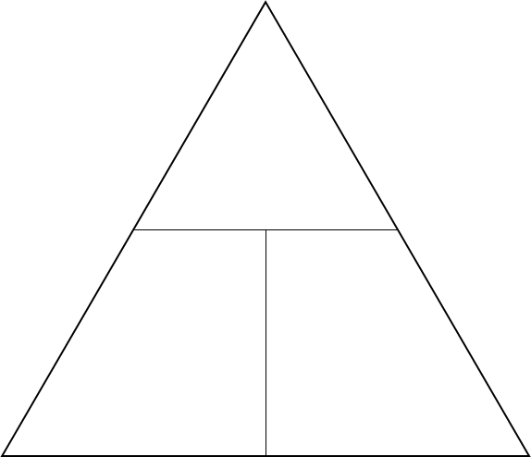
Motion Revision Worksheet
Draw a distance/time graph for the following scenario.
Mr Foster walks 10 metres from his classroom in 15 seconds, stops for 5 seconds realises he forgot his coffee and rushes back in 5 seconds.
Someone is walking along at 1.5m/s, 10 seconds later they are running at 8m/s. Calculate their acceleration:
acceleration=
Fill in the following table:
 | Vector | Scalar
Definition
Examples
Draw a velocity/time graph for the following scenario.
A bus starts from stationary and 20seconds later is doing 12m/s. It maintains this speed for 10 seconds before accelerating to 15m/s 5 seconds later. 20 seconds later the bus has stopped again.
Write down the equation for calculating speed and complete the formula triangle:
Speed =
Using your distance/time graph calculate Mr. Fosters speed when rushing back to his classroom:
Speed=
Define acceleration: ………………………………………
…………………………………………………………………………………………………………………………………………………………………………………………………………………………………………………………………………………………………………………...
A car travels 2minutes at 9m/s, calculate how far they travelled:
distance=
What is the difference between average speed and instantaneous speed?
………………………………………………………………………………………………………………………………………………………………………………………………………………………………………………………………………………………………………………………………………………………………………………………………………………………………………………………………
Write down the equation for calculating acceleration and complete the formula triangle:
acceleration =
What is the value of acceleration due to gravity? ………………
Why might an object in free fall not accelerate at this rate? ………………………………………………………………………………………………………………………………………………………………………………………………

Slide 2
Motion Revision Worksheet
Using your velocity/time graph calculate the distance travelled in the first stage of the bus journey.
Distance=
Rate each of the learning outcomes for how you feel about them:
CP1.1 Describe the difference between weight and mass.
CP1.2 Explain the difference between a vector and a scalar quantity.
CP1.2 Describe the difference between displacement and distance.
CP1.2 & CP1.3 Describe the difference between velocity and speed.
CP1.2 Define the terms: acceleration, force, momentum, energy.
CP1.4 Recall formulae relating distance, speed and time.
CP1.4 Use formulae relating distance, speed and time.
CP1.10 Recall typical speeds for walking, running, cycling and travelling by car.
CP1.5 Interpret distance/time graphs (including recognising what the steepness of the line tells you).
CP1.5 Represent journeys on distance/time graphs.
CP1.5 Determine speed from the gradient of a distance/time graph.
CP1.6 Recall the formula relating acceleration, velocity and time.
CP1.6 Use the formula relating acceleration, velocity and time.
CP1.7 Recall the formula relating acceleration, velocity and distance.
CP1.7 Use the formula relating acceleration, velocity and distance.
CP1.12 Recall the acceleration in a free fall.
CP1.12 Estimate the magnitudes of some everyday accelerations.
CP1.8 Represent journeys on velocity/time graphs.
CP1.8 Interpret velocity/time graphs qualitatively.
CP1.8 Calculate uniform accelerations from the gradients of velocity/time graphs.
CP1.8 Determine the distance travelled from the area under a velocity/time graph.
Complete the following table, comparing what lines mean on distance/time graphs and velocity/time graphs:
 | Distance/time graph | Velocity/time graph
A horizontal line.
A sloping line upwards.
A sloping line downwards.
What are the units that we commonly use for the following measures:
Speed: …………
Velocity: …………
Acceleration: …………
Time: …………
Distance: ……………
Displacement: ……………

Slide 3
Motion Revision Worksheet
Draw a distance/time graph for the following scenario.
Mr Foster walks 10 metres from his classroom in 15 seconds, stops for 5 seconds realises he forgot his coffee and rushes back in 5 seconds.
Someone is walking along at 1.5m/s, 10 seconds later they are running at 8m/s. Calculate their acceleration:
A= v-u/t
A= 8-1.5/t
A= 0.65m/s²
acceleration= 0.65m/s²
Fill in the following table:
 | Vector | Scalar
Definition | A quantity that has direction and magnitude | A quantity that has only size
Examples | Velocity Acceleration Force Displacement | Speed Time Distance
Draw a velocity/time graph for the following scenario.
A bus starts from stationary and 20seconds later is doing 12m/s. It maintains this speed for 10 seconds before accelerating to 15m/s 5 seconds later. 20 seconds later the bus has stopped again.
Write down the equation for calculating speed and complete the formula triangle:
Speed = distance/ time
Using your distance/time graph calculate Mr. Fosters speed when rushing back to his classroom:
10/5 = 2m/s
Speed= 2 m/s
d
Define acceleration:
The change in velocity over time
Speeding up
s
t
A car travels 2minutes at 9m/s, calculate how far they travelled:
2 x 60 = 120s
d=sxt
d= 9 x 120
d= 1080m
distance= 1080m
What is the difference between average speed and instantaneous speed?
The speed at any given time is instantaneous speed
Average speed is speed = distance / time
Write down the equation for calculating acceleration and complete the formula triangle:
acceleration = a= v-u/t
What is the value of acceleration due to gravity? 9.8m/s²
Why might an object in free fall not accelerate at this rate?
Due to other forces acting on the object
v-u
a
t

Slide 4
Motion Revision Worksheet
Using your velocity/time graph calculate the distance travelled in the first stage of the bus journey.
20 x 12 / 2 = 120m
Distance= 120m
Rate each of the learning outcomes for how you feel about them:
CP1.1 Describe the difference between weight and mass.
CP1.2 Explain the difference between a vector and a scalar quantity.
CP1.2 Describe the difference between displacement and distance.
CP1.2 & CP1.3 Describe the difference between velocity and speed.
CP1.2 Define the terms: acceleration, force, momentum, energy.
CP1.4 Recall formulae relating distance, speed and time.
CP1.4 Use formulae relating distance, speed and time.
CP1.10 Recall typical speeds for walking, running, cycling and travelling by car.
CP1.5 Interpret distance/time graphs (including recognising what the steepness of the line tells you).
CP1.5 Represent journeys on distance/time graphs.
CP1.5 Determine speed from the gradient of a distance/time graph.
CP1.6 Recall the formula relating acceleration, velocity and time.
CP1.6 Use the formula relating acceleration, velocity and time.
CP1.7 Recall the formula relating acceleration, velocity and distance.
CP1.7 Use the formula relating acceleration, velocity and distance.
CP1.12 Recall the acceleration in a free fall.
CP1.12 Estimate the magnitudes of some everyday accelerations.
CP1.8 Represent journeys on velocity/time graphs.
CP1.8 Interpret velocity/time graphs qualitatively.
CP1.8 Calculate uniform accelerations from the gradients of velocity/time graphs.
CP1.8 Determine the distance travelled from the area under a velocity/time graph.
Complete the following table, comparing what lines mean on distance/time graphs and velocity/time graphs:
 | Distance/time graph | Velocity/time graph
A horizontal line. | Stationary | Constant Speed
A sloping line upwards. | Moving away at a constant speed | Accelerating
A sloping line downwards. | Returning to where the journey began at a constant speed. | Decelerating
What are the units that we commonly use for the following measures:
Speed: m/s
Velocity: m/s
Acceleration: m/s²
Time: Seconds
Distance: Meters
Displacement: Meters

