Slide 1
Year 10
Information Evening.
GCSE Mathematics.
Notes:
1

Slide 2
Edexcel (1MA1)
3 Exam papers
Higher tier covers grades 9 to 4
Foundation tier covers grades 5 to 1
Each paper lasts 90 minutes
Each paper is worth 80 marks
GCSE Mathematics
Notes:
2

Slide 3
GCSE Mathematics
Exam dates
Paper 1 (non-calculator): Friday 19th May
Paper 2 (calculator): Tuesday 6th June
Paper 3 (calculator): Monday 14th June
Notes:
3

Slide 4
GCSE Mathematics
Assessments:
Throughout Year 10
End of Year 10
two GCSE papers
Year 11 - October and December.
Notes:
4

Slide 5
Relevant topics: December mock QLA.
Notes:
5

Slide 6
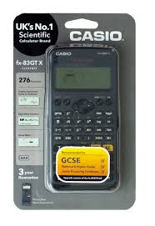
GCSE Mathematics
Paper 2 & Paper 3 require the use of a scientific calculator.
We recommend Casio fx-83GT Plus.
£9.00
…but….
Notes:
6

Slide 7
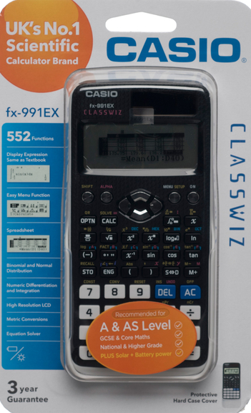
GCSE Mathematics
….for those who may be thinking of ‘A’ level Maths, or ‘A’ level physics
we recommend Casio fx-991EX.
£20.00
Notes:
7

Slide 8
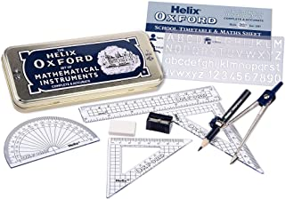
Encourage your child to seek out their maths teacher if they are struggling with work in class; or a topic they are revising.
Ensure you child has all the correct equipment
Ensure your child is revising relevant topics.
What you can do to help
Notes:
8

Slide 9
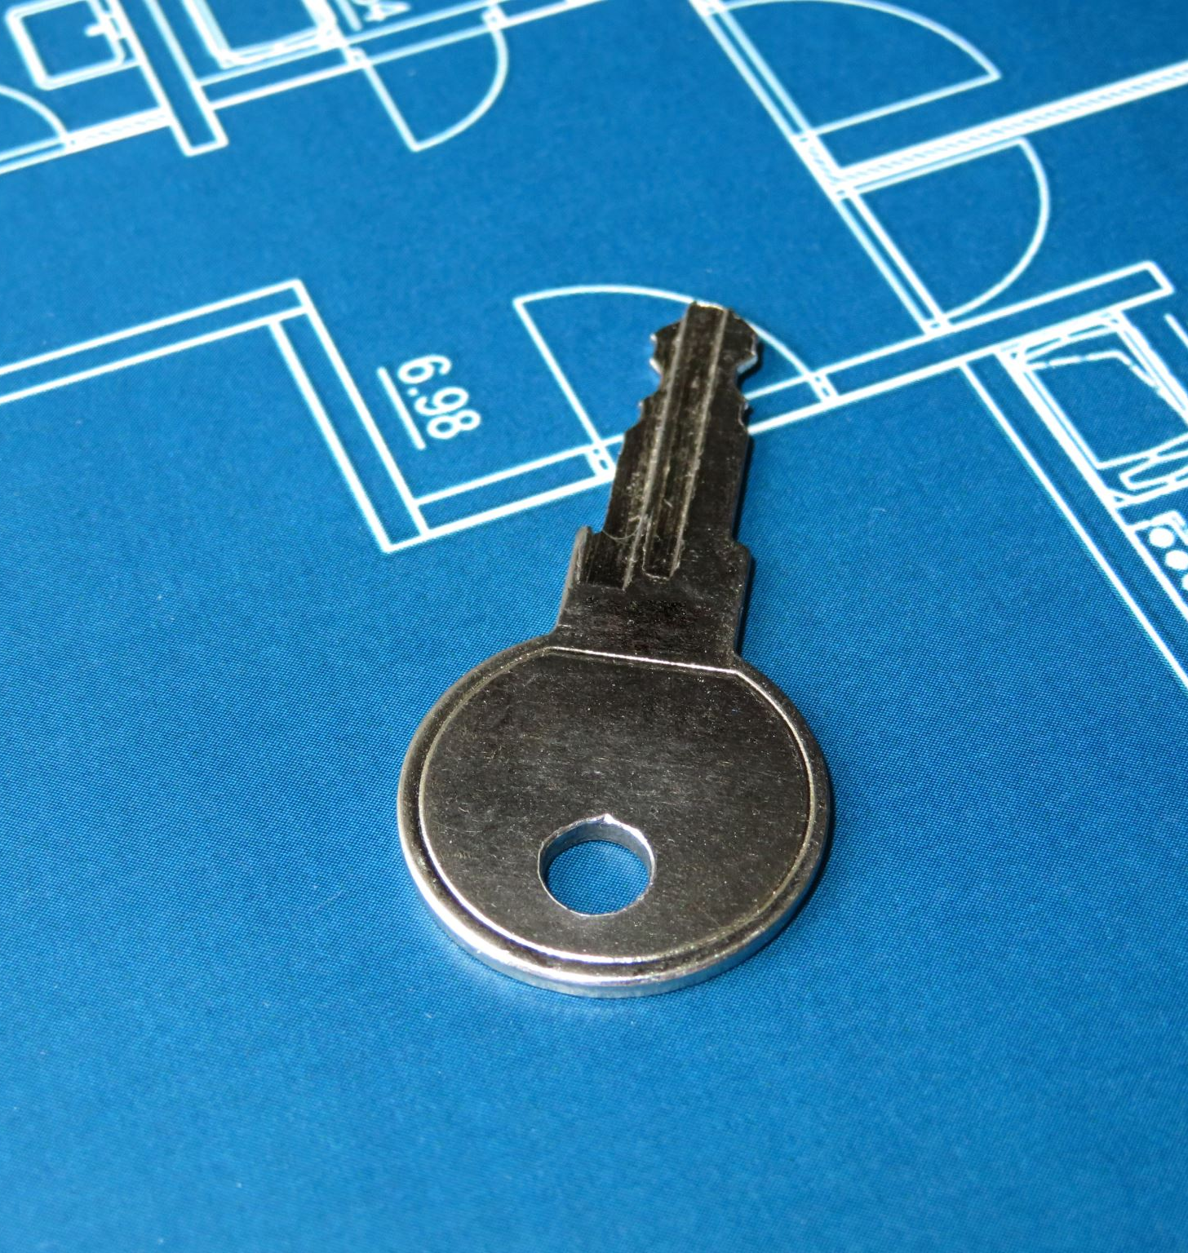
Key websites for revision

Slide 10
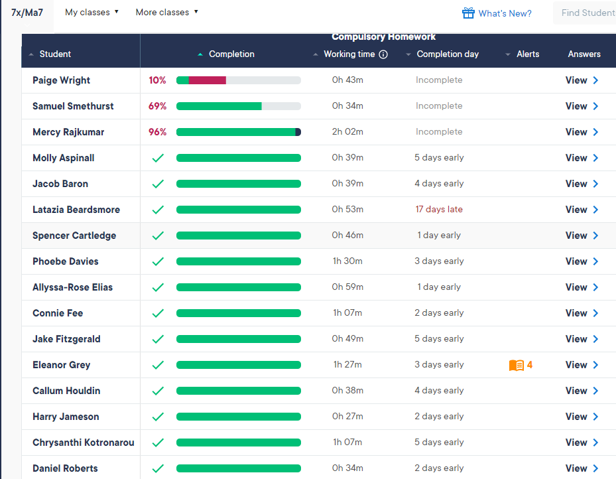
Websites students should be using: sparxmaths.uk
Notes:
10

Slide 11
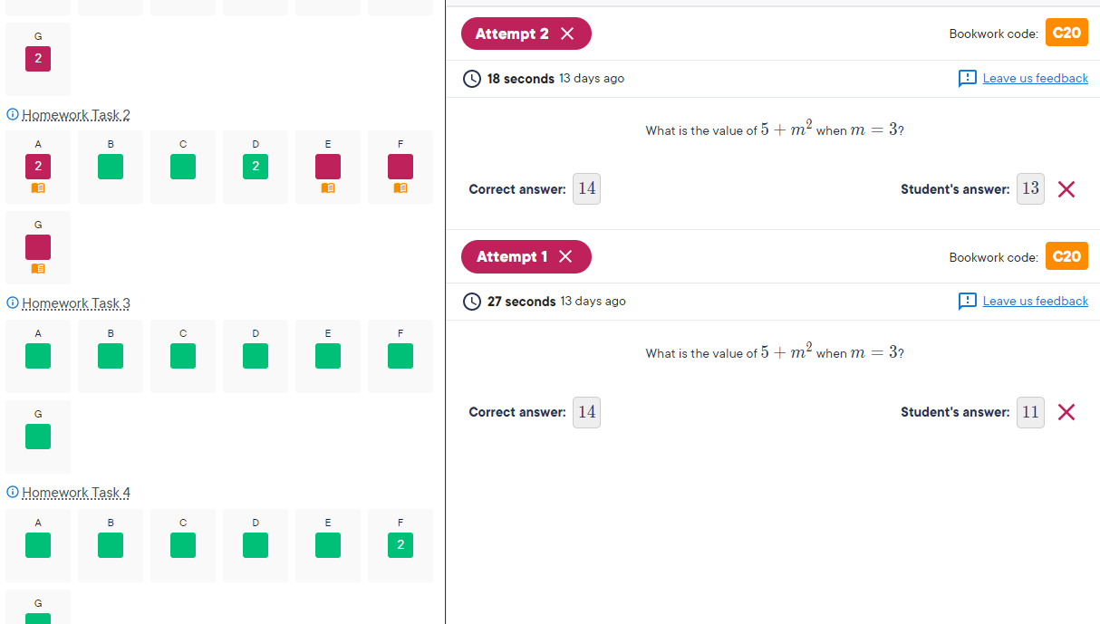
Websites students should be using: sparxmaths.uk
Notes:
11

Slide 12
Websites students should be using:
mathsgenie.co.uk
No login needed.
Notes:
12

Slide 13
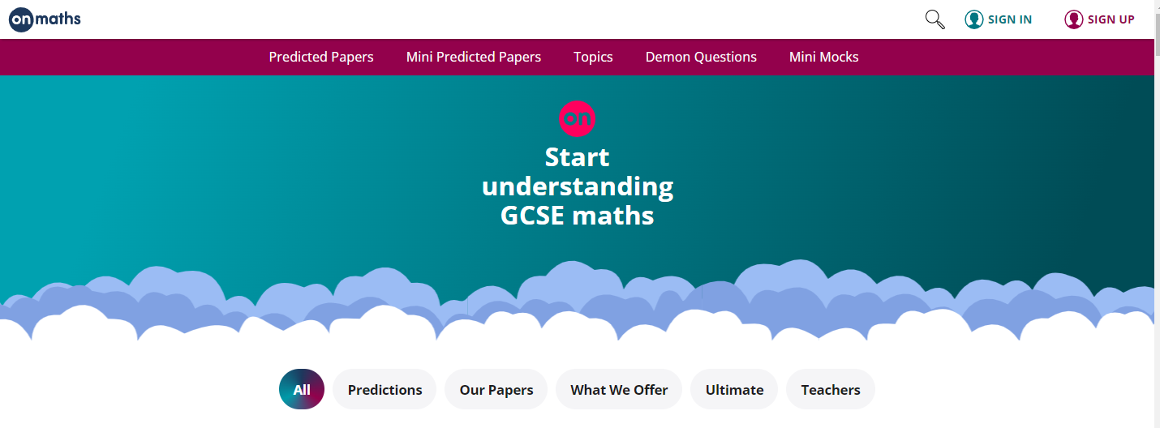
Websites students should be using:
onmaths.com
No login needed.
Notes:
13

Slide 14
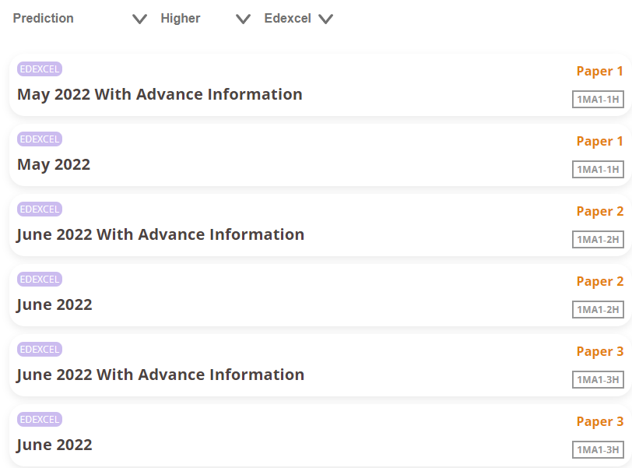
Websites students should be using:
onmaths.com
No login needed.
Notes:
14

Slide 15
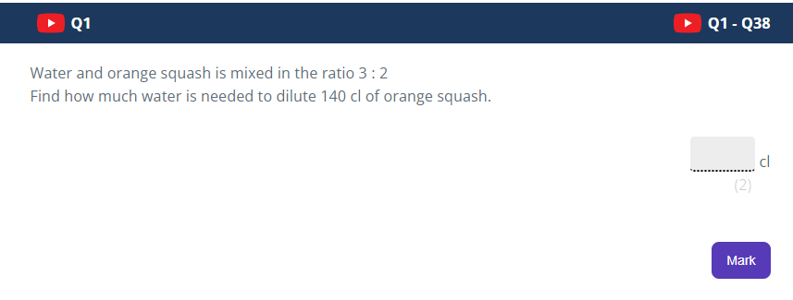
Websites students should be using:
onmaths.com
No login needed.
Notes:
15

Slide 16
Websites students should be using:
Pensbyhighschool.com
Notes:
16

Slide 17
corbettmaths.com
No login needed.
There are videos, worksheets, practice papers to use.

Slide 18
corbettmaths.com

Slide 19
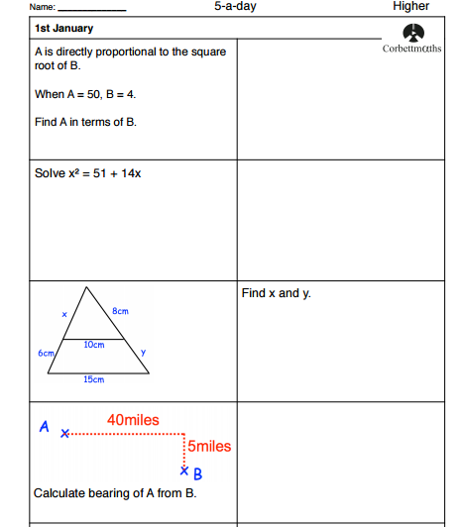

Slide 20
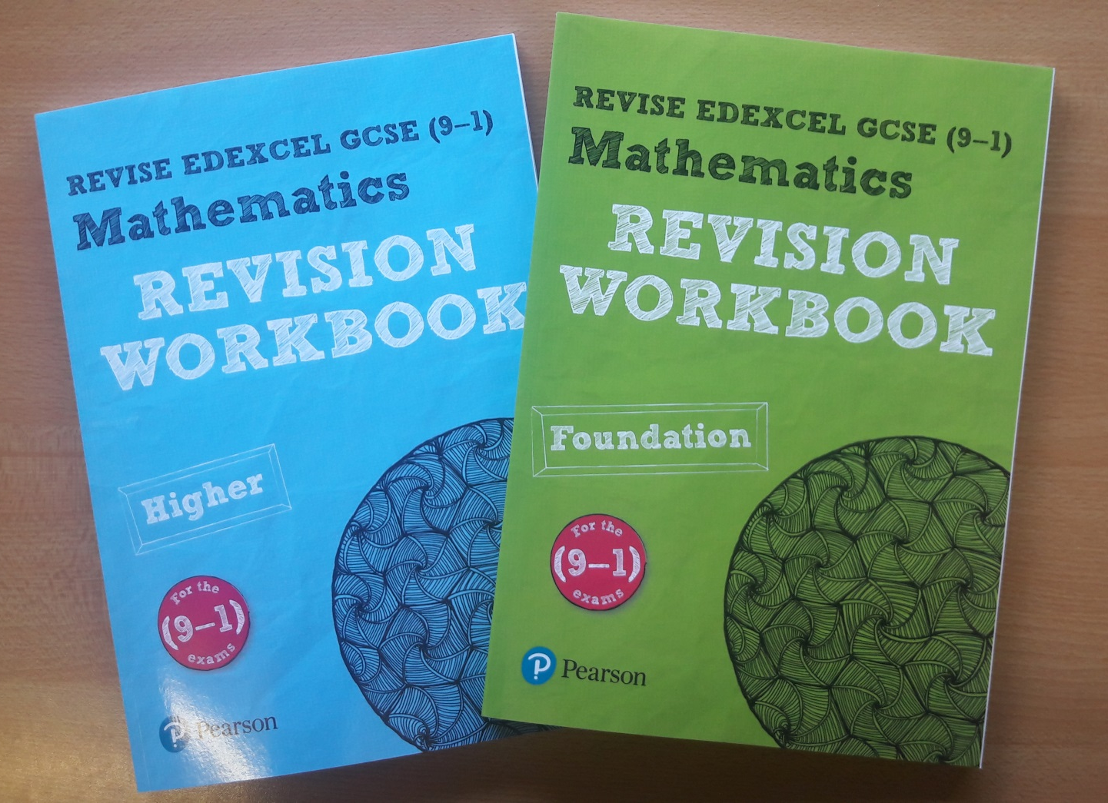
GCSE Mathematics
Pearson (Edexcel) revision workbooks
£5
Notes:
20

