Slide 1
Year 10 What is an Art Journal
An art journal, or artist's journal, is a book kept by an artist as a visual, and sometimes verbal, record of her thoughts and ideas. Art journals generally combine visual journaling and writing, to create finished pages. Every imaginable style, media and technique is used by art journalists.

Slide 2
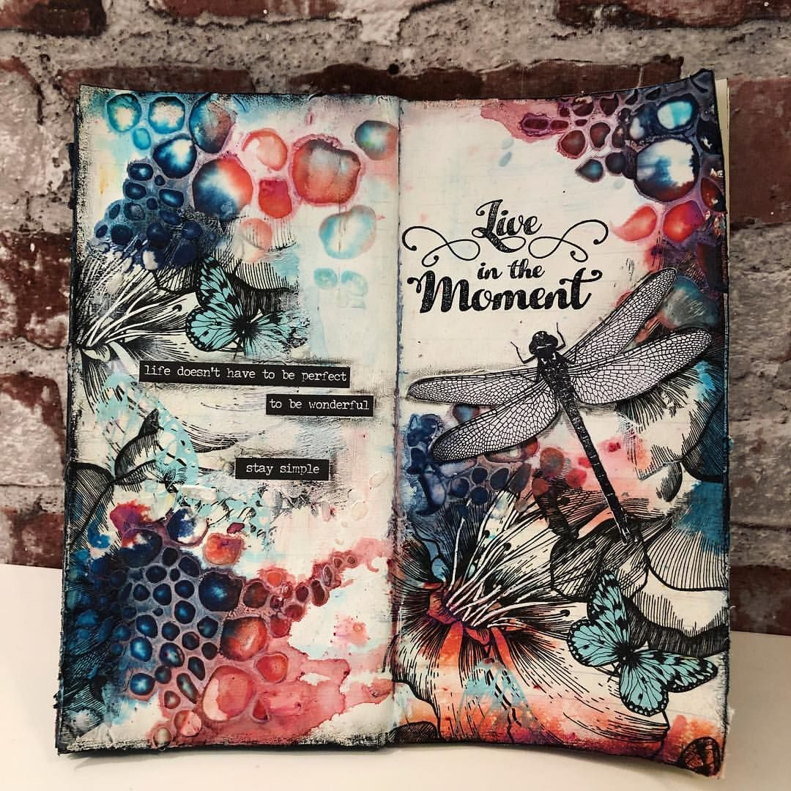
Art Journaling

Slide 3
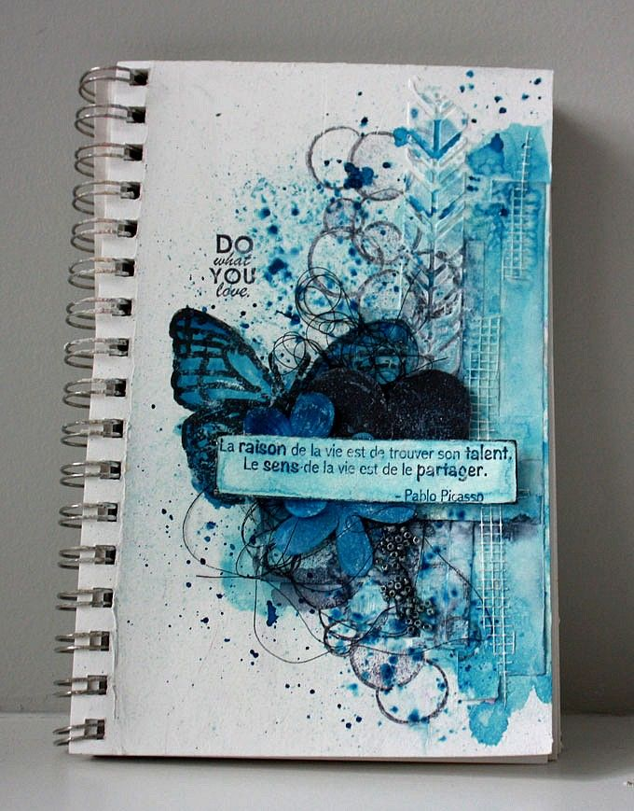
Art Journaling

Slide 4
Teesha Moore creates Art Jounals;
Create your own art journal pages.
Produce a ground i.e. coffee/book page etc.
You my draw a large insect or a portrait (or both) in the middle of the page. Use a variety of different media-
Incorporate patterns, printing marks (could use a cork/bubble wrap to print?). Can also print over parts of your main drawing?
Add lettering to convey a message? Could use newspaper type? Could rip patterns out of magazines to incorporate?

Slide 5
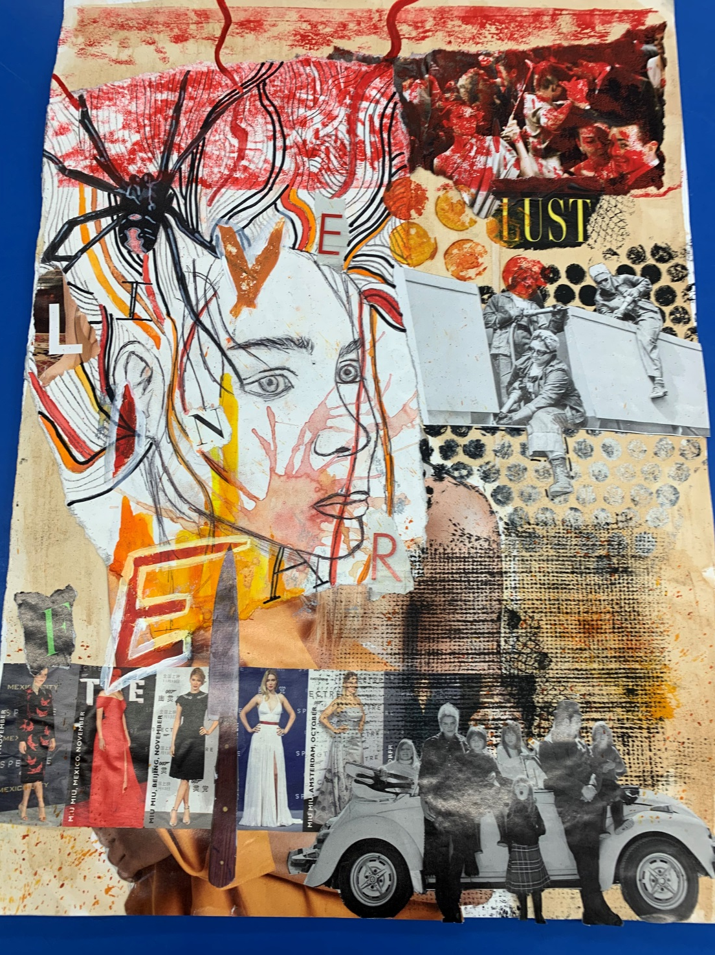
Piece inspired by Teesha Moore. Hannah has incorporated her portrait with a spider. She has made interesting marks by printing with bubble wrap.

Slide 6
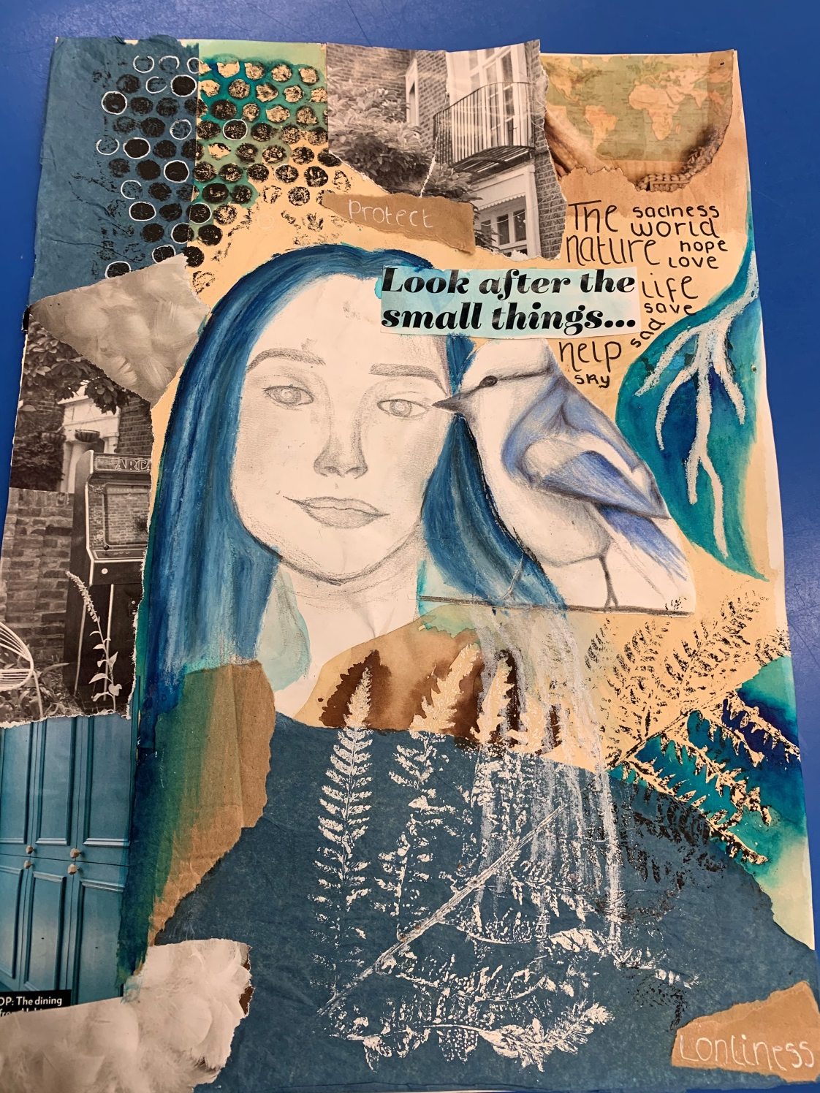
Piece inspired by Teesha Moore. Grace has incorporated her portrait with a bird. She has made interesting marks by printing with bubble wrap and leaves.
You don’t have to include a portrait and could enlarge an interesting insect, butterfly or bird.

Slide 7
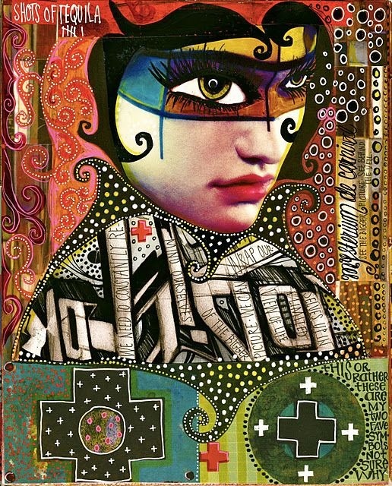
Teesha Moore- Born 1963

Slide 8
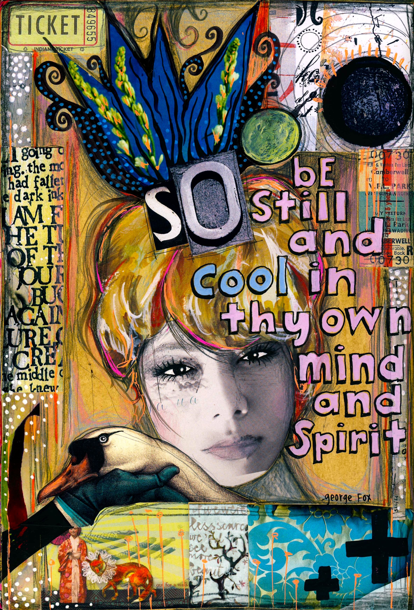
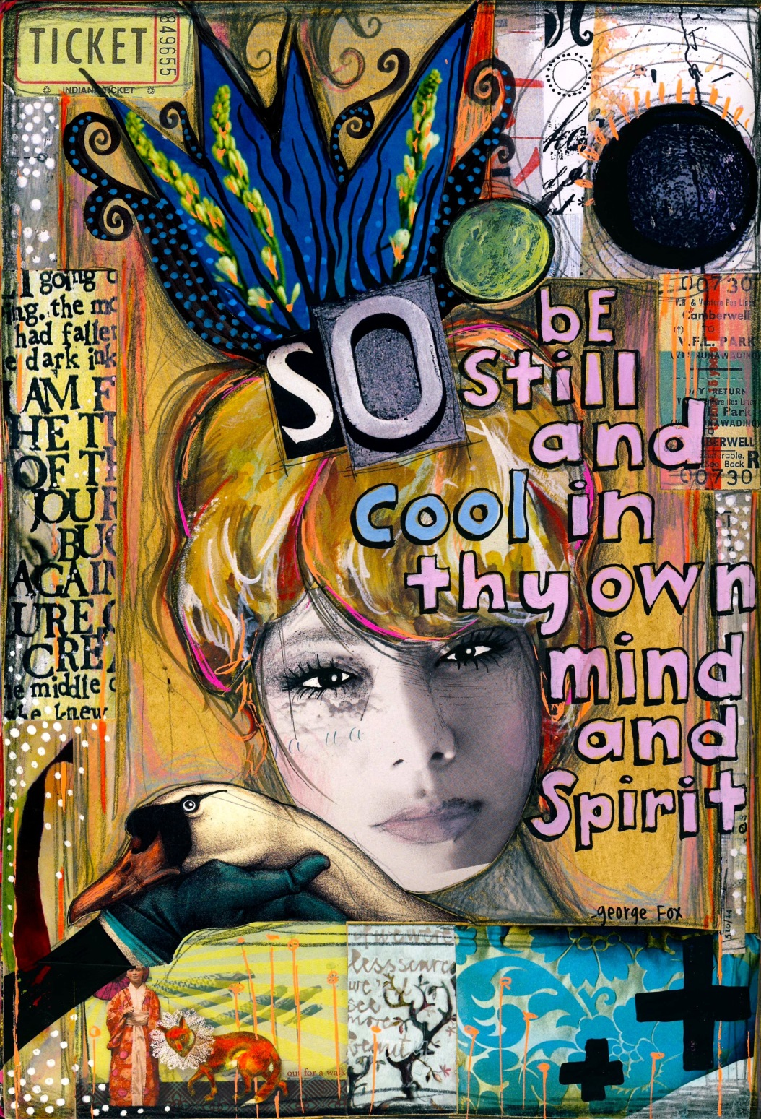
Teesha Moore- Born 1963

Slide 11
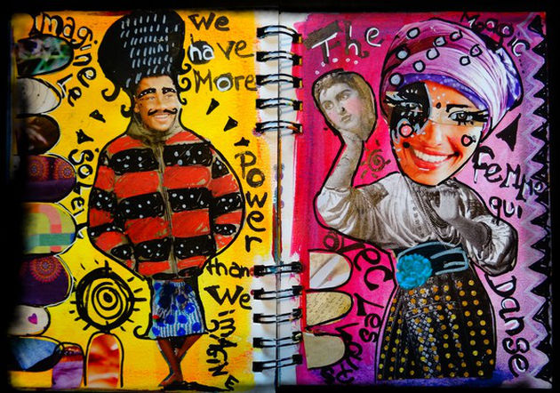
Teesha Moore

Slide 12
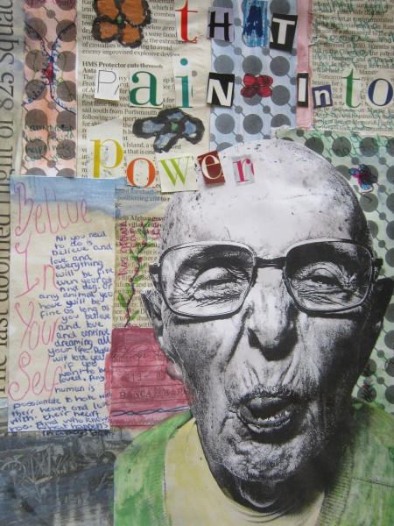

Slide 13
