Slide 1
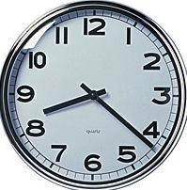
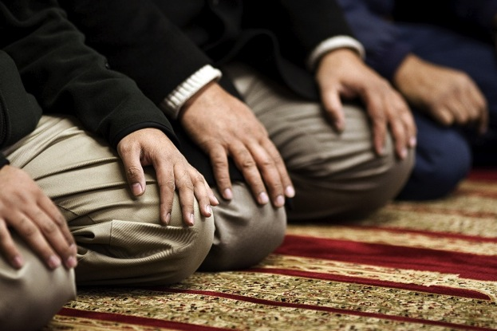
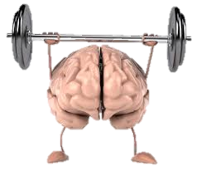
Monday, 30 March 20
Salah: the daily prayers
Learning Intentions:
To know when Muslims pray and how they prepare for prayer
To understand the importance of facing Makkah when praying.
Are there any benefits of regular prayer?
https://www.truetube.co.uk/film/muslim-prayer
Challenge: Explain why someone may think that regular prayer is not beneficial.

Slide 2
Salah: the daily prayers
Learning Intentions:
To know when Muslims pray and how they prepare for prayer
To understand the importance of facing Makkah when praying
Progress Indicators
I can describe how Muslims prepare for prayer
I can explain the importance of facing Makkah when praying
I can clearly explain how prayer happens inside a mosque

Slide 3
The Five Pillars of Islam
Shahadah
Salah
Zakat
Sawm
Hajj
The declaration of faith
Pray
5 times
A day
Give 2.5% of earnings to charity
Fasting during Ramadan
Pilgrimage to Mecca

Slide 4
Salah: prayer with and in worship of God, performed under conditions set by the prophet Muhammad
wudu: ritual washing before prayer
mihrab: a niche in a wall that indicates the direction of Makkah
qiblah wall: the wall in a mosque that contains the mihrab
Rak’ah: a sequence of movements in ritual prayer
Recitation: repeating a passage of text from memory
Prostration: kneeling with the forehead, nose, hands, knees and toes touching the floor, in submission to God.
Jummah prayer: a weekly communal prayer performed after midday on Friday, which includes a sermon.

Slide 5
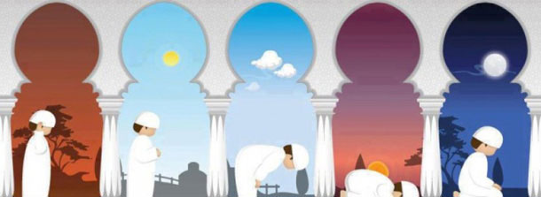
The times of prayer
To follow the second pillar of Islam (salah), Sunni Muslims are required to pray 5 times a day. The prayers take place at set times, and they are worked out from the times of sunrise to sunset. This means that they will change slightly each day.
Fajr
Just before sunrise
Asr
Afternoon
Isha
Night
Shi’a Muslims combine the midday and afternoon prayers, and the sunset and the night prayers, so they pray 3 times a day.
Zuhr
Just after midday
Maghrib
Just after sunset
Challenge: Why do you think Muslims organise their prayers this way?
Explain when Muslims are expected to pray and how they know when these times are.

Slide 6
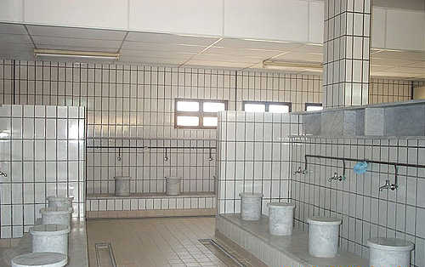
How does Muslims prepare for prayer?
It is important that Muslims are spiritually clean before they pray. This is achieved by ritual washing (or ablution called wudu.
Mosques have two special rooms for washing, one for men and one for women.
If water is not available, for example in the desert, a dry form or washing is allowed using sand or dust. This shows that it is not physical cleanliness that is require but spiritual cleanliness. Wudu is a form or spiritual preparation to allow Muslims to focus fully on God in their prayers.
“You who believe, when you are about to pray, wash your faces and your hands up to the elbows, wipe your heads wash your feet up to the ankles and, if required was your whole body.”
Qur’an 5:6
http://www.bbc.co.uk/programmes/p02mwhw0

Slide 7
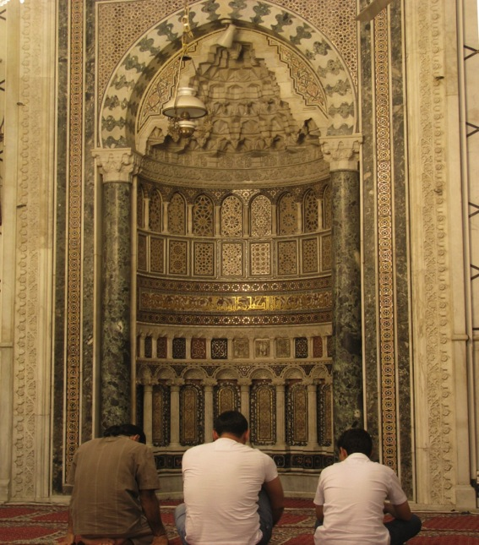
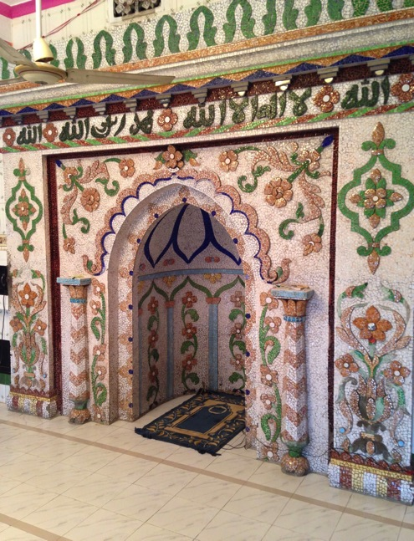
The direction of prayer
When praying, Muslims should face the holy city of Makkah. This means that all Muslims are physically and mentally focusing on one place associate with God, in the same way that all Muslims should focus every part of their lives to God. If all prayers are taking place in a mosque, this is easy to achieve.
All mosques have a mihrab, this is a semi-circular niche built into the qiblah wall. This shows the exact direction or Makkah from the mosque. Muslims face this in order to pray

Slide 8
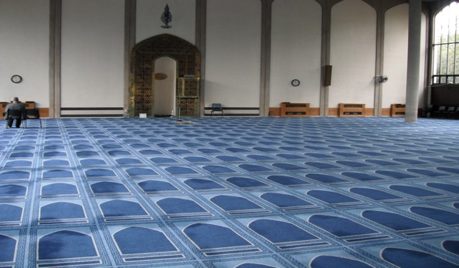
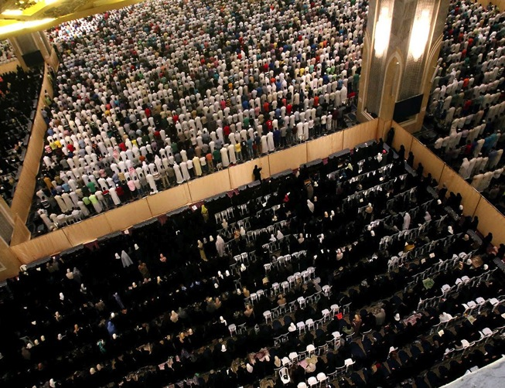
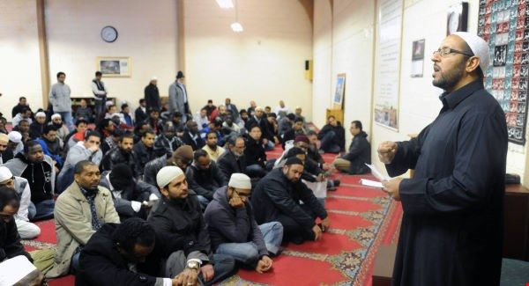
Prayer inside a mosque
Many mosques have special carpet that look like separate rows or prayer mats, facing the mihrab. This gives each person a suitable space to carry out their prayers properly.
Prayers are led by an Imam, who is positioned at the front of the congregation.
Men and women pray in separate spaces. The voice of the imam is often broadcast in the women’s prayer room at the same time, so that he can lead their prayers along with the men’s.
http://www.bbc.co.uk/programmes/p02mwjhx

Slide 9
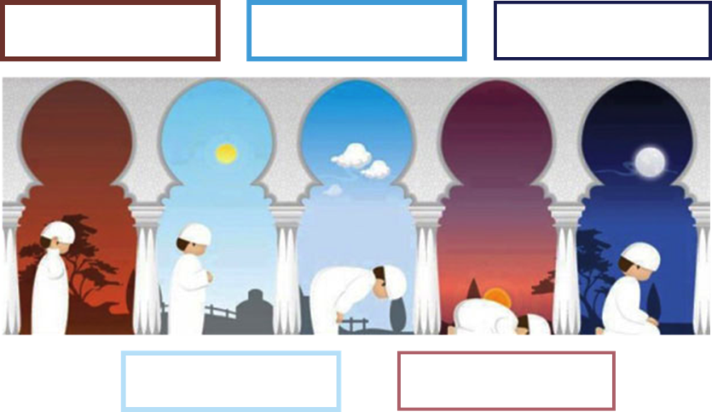
Salah: the daily prayers (1)
Lesson focus:
Key Words:
Salah:
wudu:
mihrab:
qiblah wall:
Are there any benefits of regular prayer?
Explain when Muslims are expected to pray and how they know when these times are.
Challenge: Explain why someone may think that regular prayer is not beneficial.
Challenge: Why do you think Muslims organise their prayers this way?
What is wudu?
Why do Muslims believe it is important?
What direction so Muslims pray and why?
How do Muslims know which way to pray when they are in a mosque?
Explain how the layout of a mosque makes it easier for Muslims to pray correctly. (Give at least 2 examples)
“You who believe, when you are about to pray, wash your faces and your hands up to the elbows, wipe your heads wash your feet up to the ankles and, if required was your whole body.”
Qur’an 5:6
Learning Intentions: To know when Muslims pray and how they prepare for prayer and understand the importance of facing Makkah when praying.

Slide 10
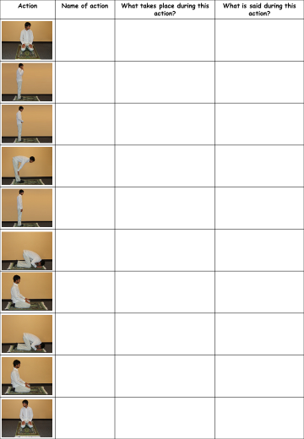
The Rak'ah
The daily prayers are made up of a number of rak’ah, this is a set sequence of actions and recitations.
Read through the different actions and match them up to the picture. Make sure you write the name of the action and what takes place.
Challenge: Do you think having a set sequence for prayer is a good idea? Explain your opinion.

Slide 11
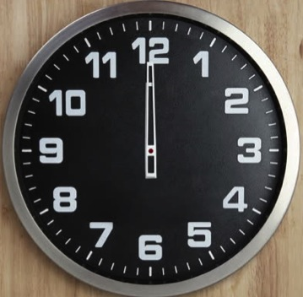
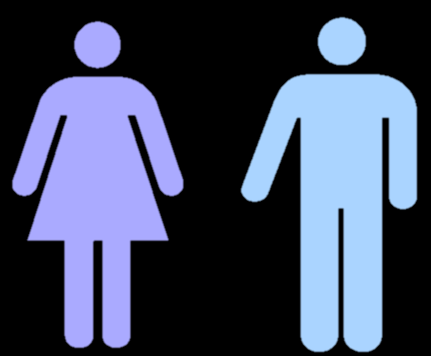
Jummah prayer
The midday prayer every Friday is considered to be special, and it is called the Jummah prayer.
Once the prayer is complete, the imam will deliver a sermon that reminds Muslims of their obligations and duties to God.
All male Muslims are expected to attend a mosque for this prayer, and woman may do so if they wish.
Although Friday is not a day of rest, Muslims must leave their work or close their business in order to attend Jummah prayer, and then return to work afterwards.

Slide 12
Prayer at home
Muslims are allowed to pray at home. They must perform wudu before prayer but they do not need a special room in their house to pray.
Muslims will use a prayer mat, which they position so it is facing Makkah, in the same way as it would in a mosque.
If Muslims are allowed to pray at home, why do you think many go to a mosque to pray?
Design a prayer mat which could be used in the home.
Muslims women can often find it useful to pray at home, especially if they have children to look after.

Slide 13
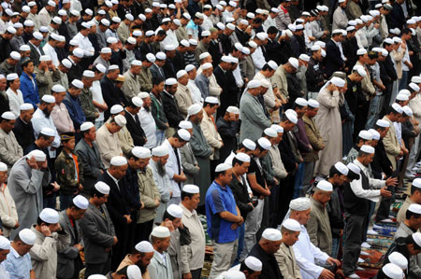
The significance of prayer
Prayer has its own importance as one of the Five Pillars. However, for Muslims it is more than that, it is what God has commanded them to do. Prayer creates a greater awareness of God, which in turn motivates them to do God’s will.
Prayer also unites Muslims worldwide because they all pray in the same way. A Muslim can go into any mosque anywhere in the world and be able to participate with fellow Muslims. In addition, reciting from the Qur’an during the prayers reminds Muslims of its importance. The actions of bowing and prostrating remind them that God is greater and more important than they are.
Explain how a Muslim might answer the question:
‘Why do you pray?’

Slide 14
Exam question
Explain two ways in which a belief in the importance of prayer influences Muslims today. [4 marks]
Remember:
You need to include two separate ways / contrasts and explain them both fully with relevant examples.
This question asks about how a belief influences Muslims today, so make sure that you apply the belief to the present day rather than just describing it.

