Slide 1
Developing an idea
You will learn now how to turn a simple 2D sketch into something that you can clearly see how it works, is assembled and basically looks similar to your final outcome
https://www.youtube.com/watch?v=QhPFb5RYsk4

Slide 2
Ways to develop
Initially 3D sketching in a step by step format. Drawings are better quality and more detailed. You have plenty of annotation (think of following a recipe in cooking, you follow a step my step method in order to make, for example, a cake. If you don’t follow the method you will make a mistake).
You can use google sketch up, 3D computer programmes are a great way to show a high quality drawing.
You can use 2D design to draw out your final design (remember this way is good as if it works first time you then don’t have to draw it out again!), just remember if you use 2D design you need to be able to deconstruct your final outcome into flat pieces (flat pack furniture!).
You can go onto google to look at modelling techniques, using fabric, clay, papier Mache, Modroc, etc.

Slide 3
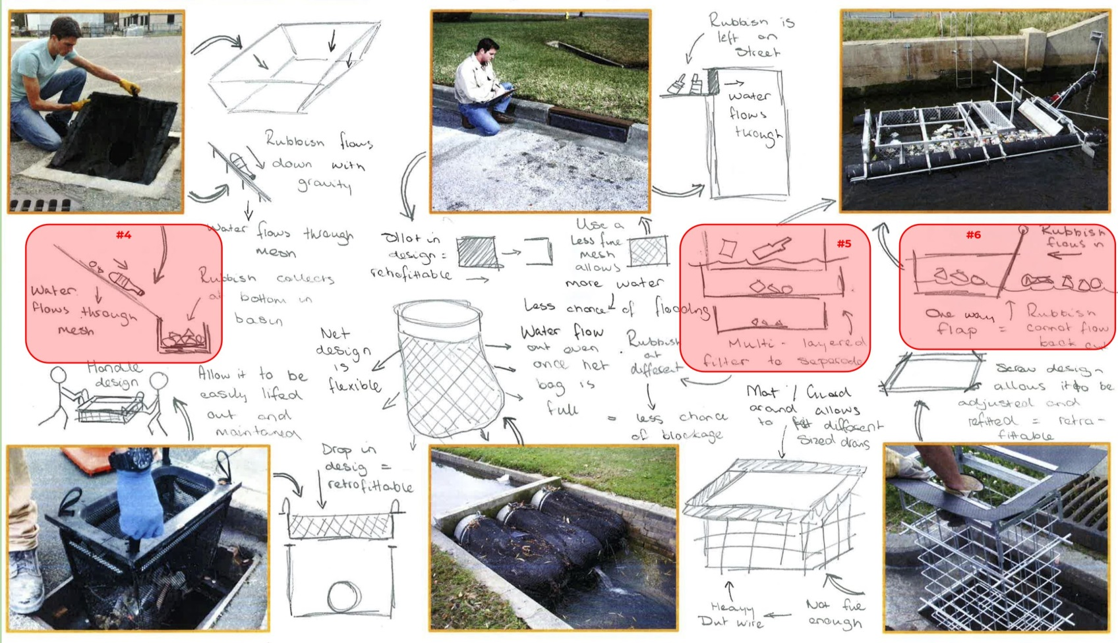
Examples of how you could display your development:

Slide 4
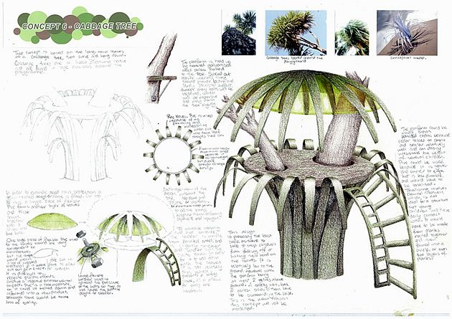
Examples of how you could display your development:

Slide 5
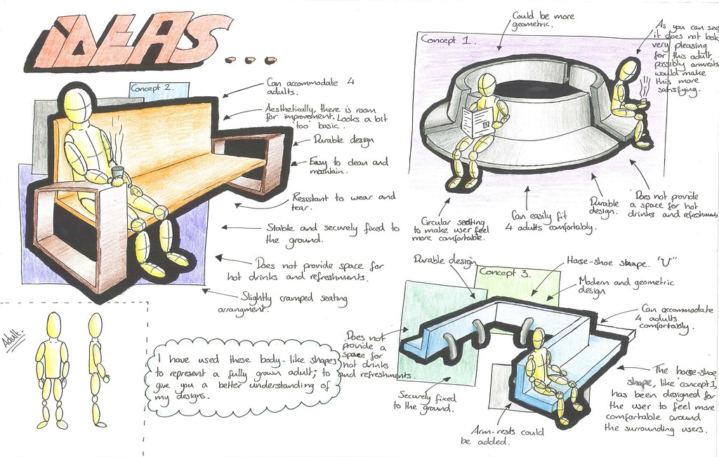
Examples of how you could display your development:

Slide 6
Examples of how you could display your development:

Slide 7
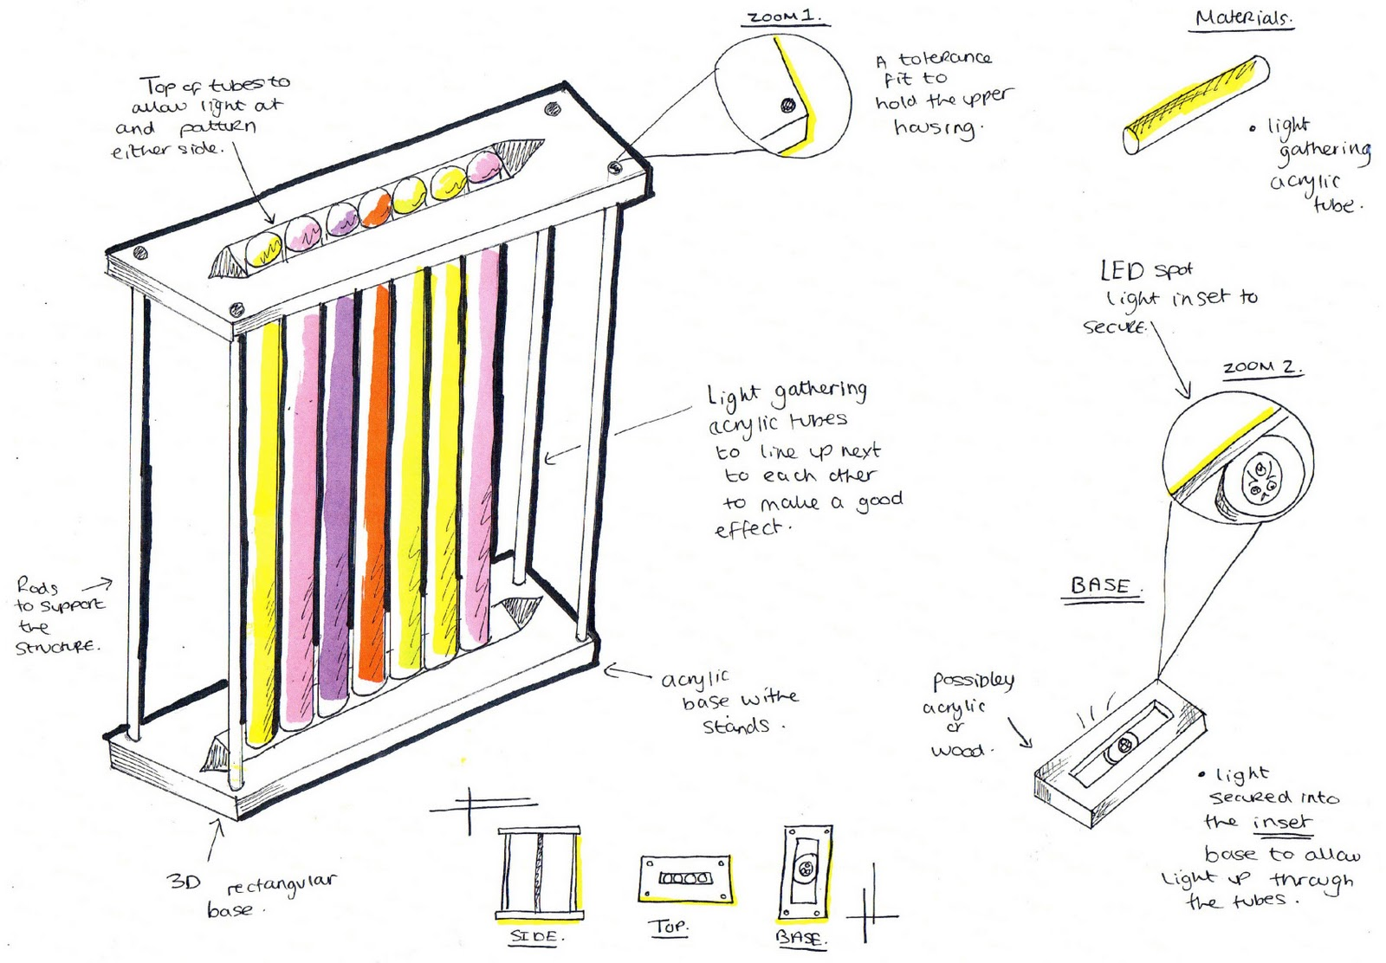
Examples of how you could display your development:

Slide 8
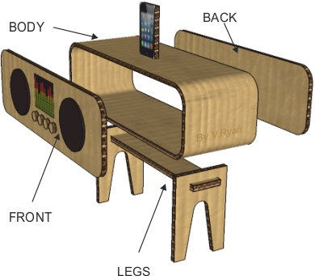
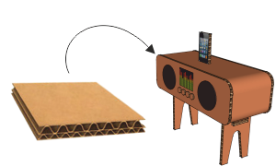
Examples of how you could display your development:

Slide 9
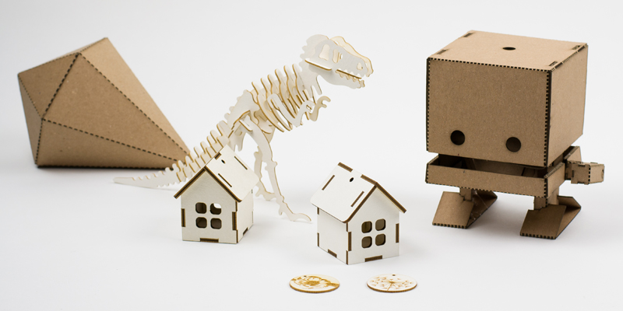
Examples of how you could display your development:

Slide 10
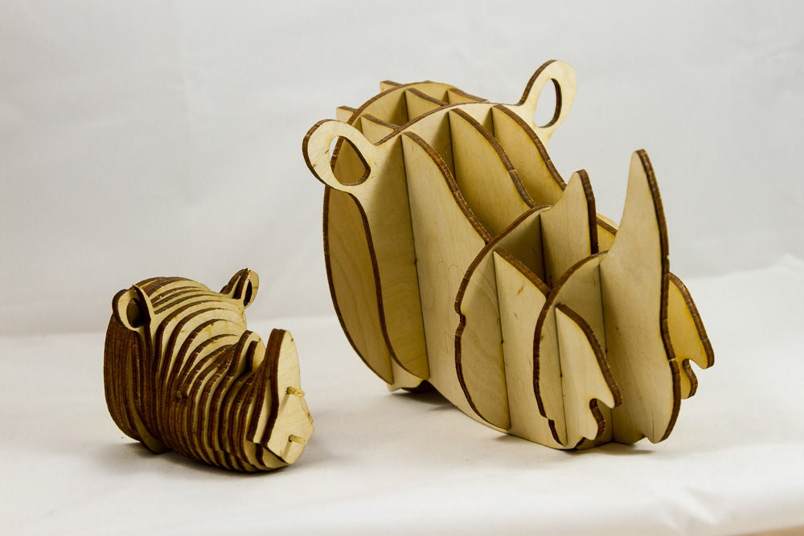
Examples of how you could display your development:

Slide 11
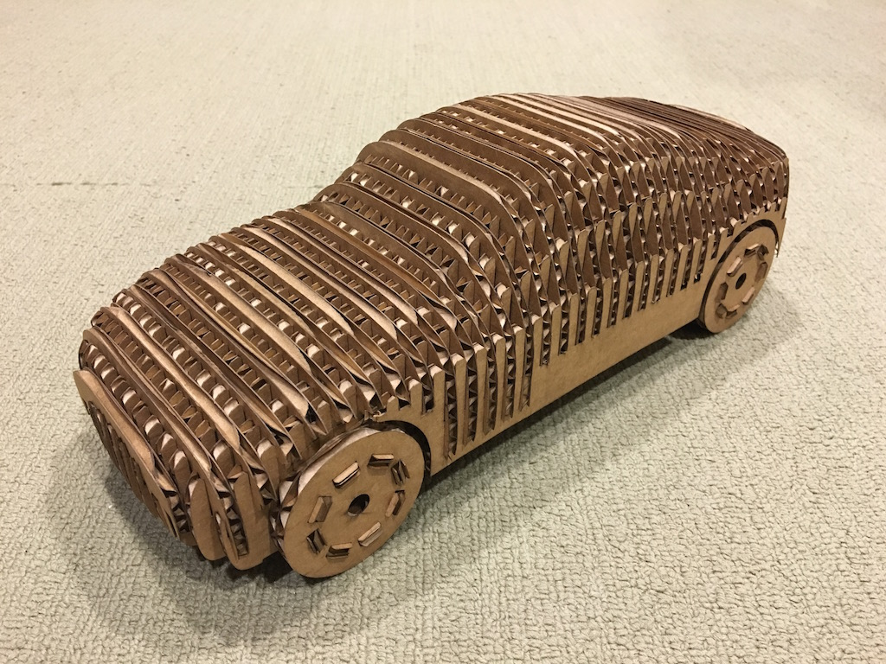
Examples of how you could display your development:

Slide 12
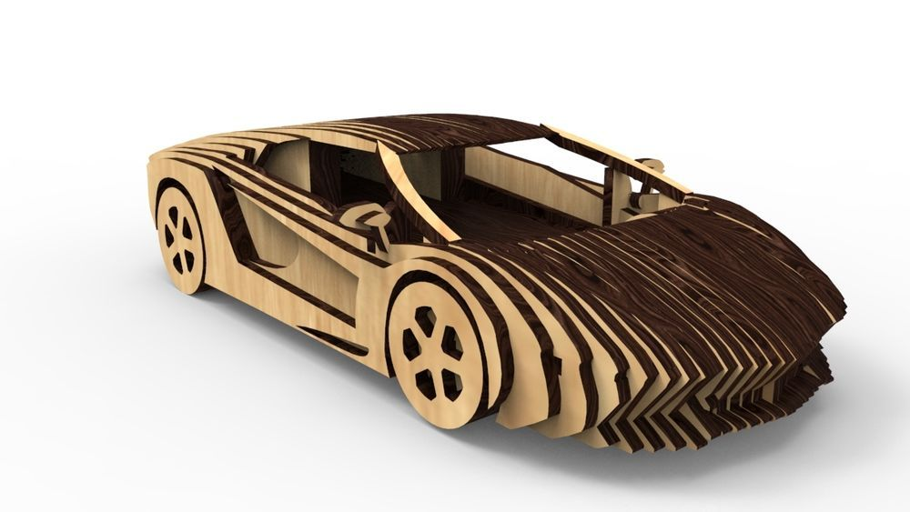
Examples of how you could display your development:

Slide 13
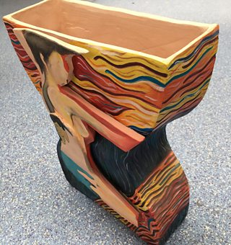
Examples of how you could display your development:

Slide 14
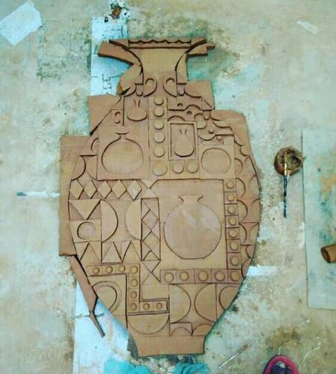
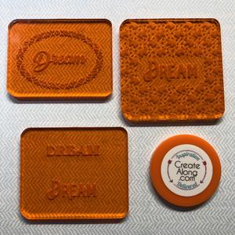
Examples of how you could display your development:

Slide 15
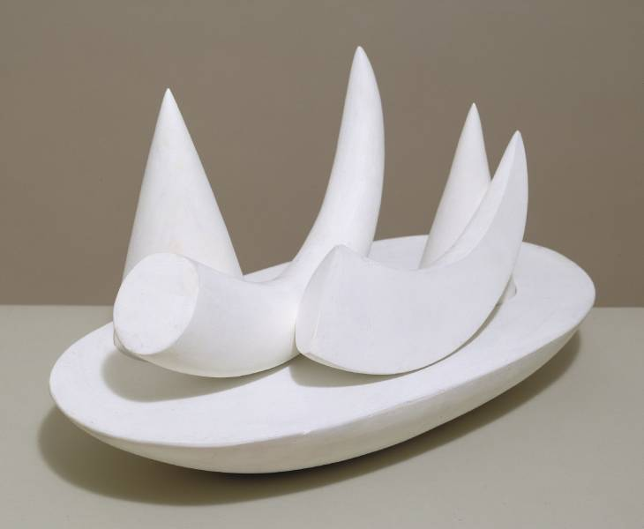
Examples of how you could display your development:

Slide 16
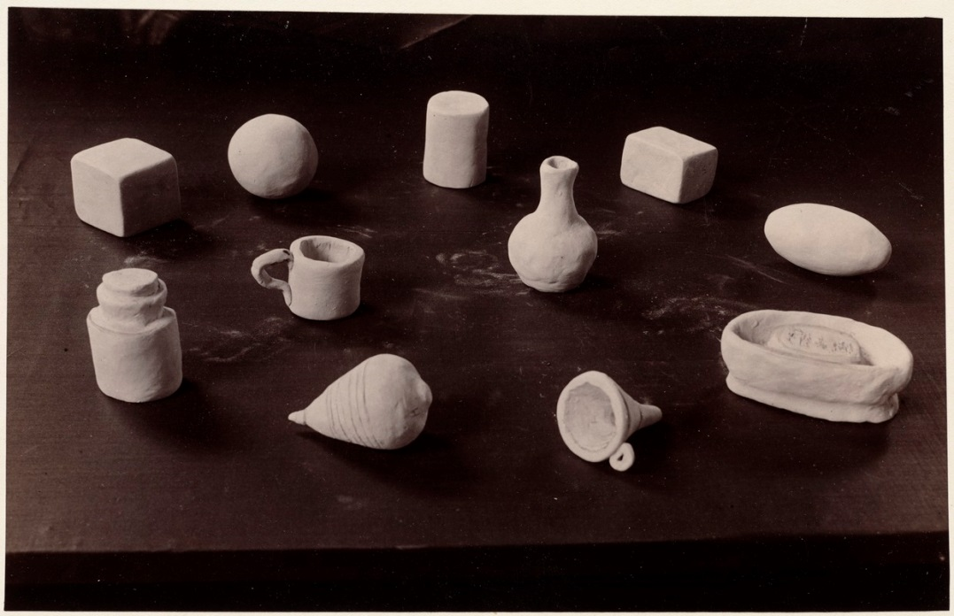
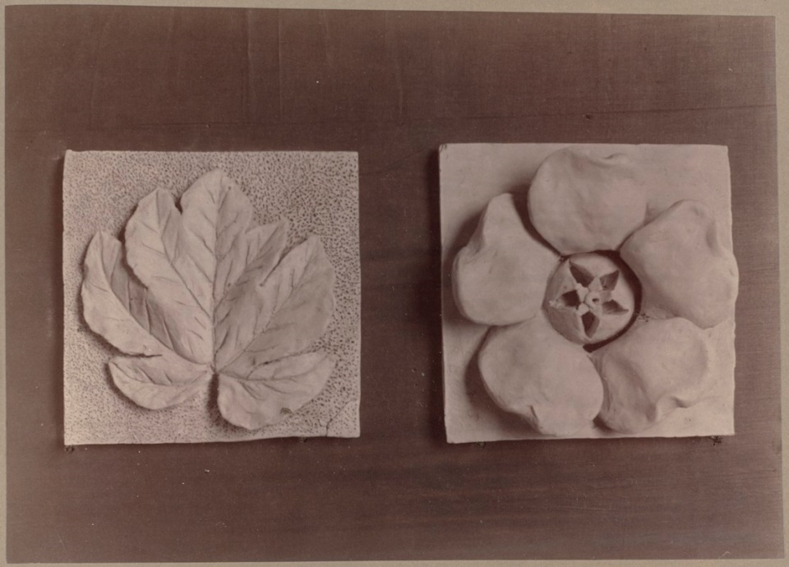
Examples of how you could display your development:

Slide 17
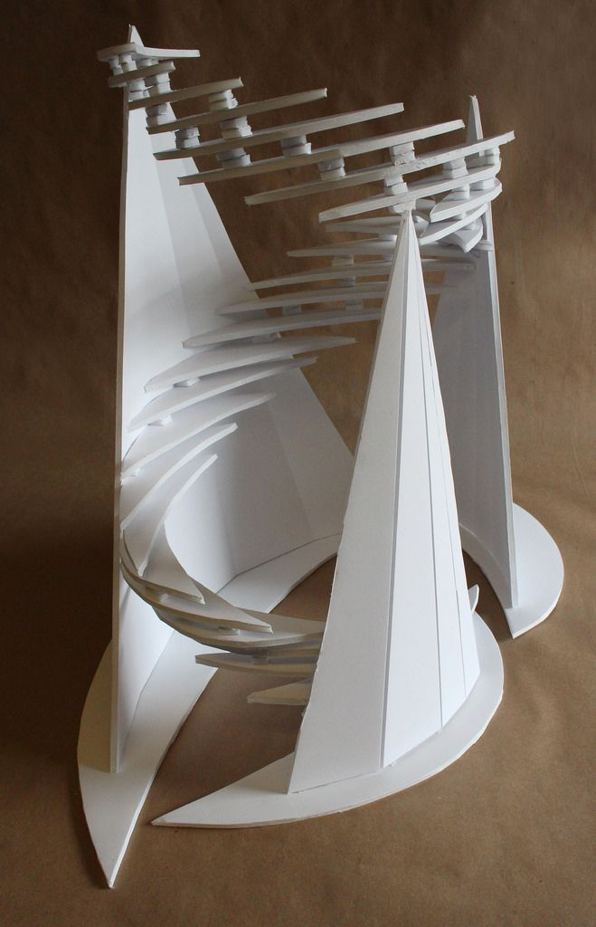
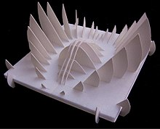
Examples of how you could display your development:

Slide 18
Examples of how you could display your development:

Slide 19
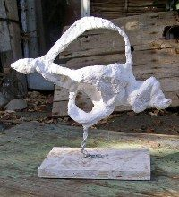
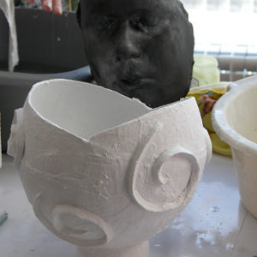
Examples of how you could display your development:

Slide 20
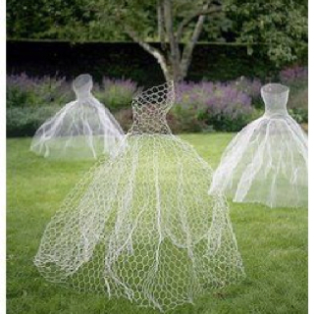
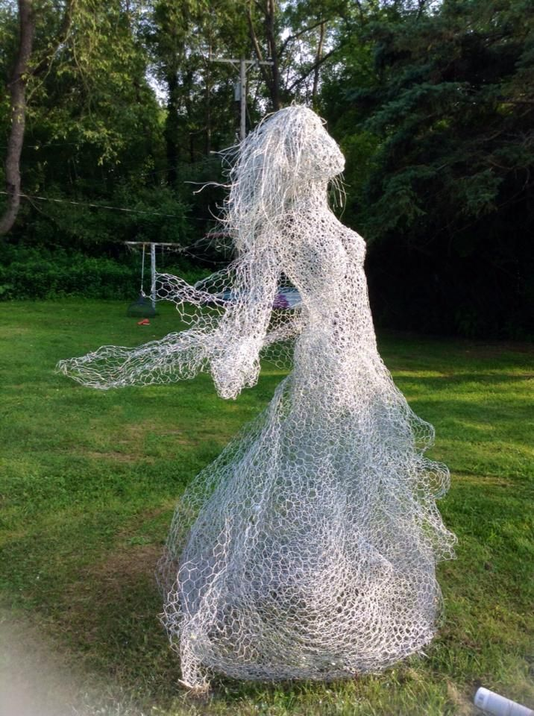
Examples of how you could display your development:

Slide 21
Examples of how you could display your development:

