Slide 1
Punctuation 5

Slide 2
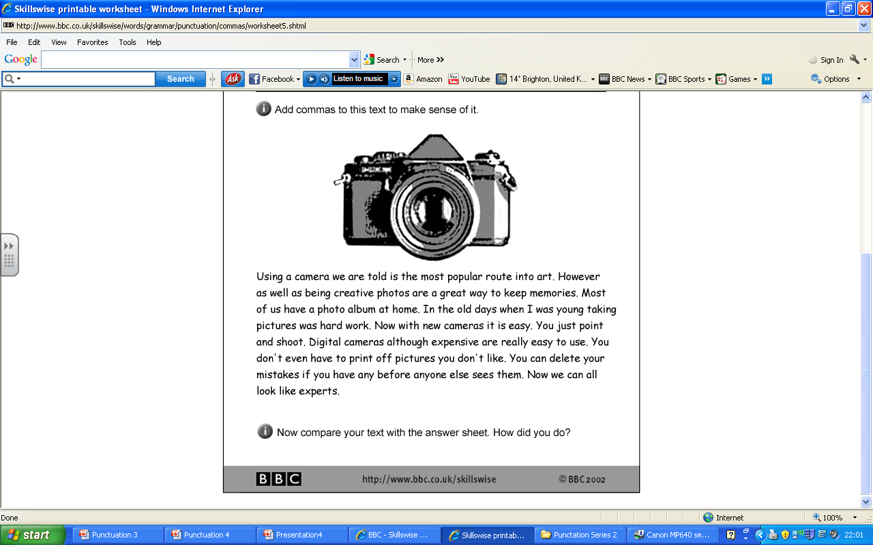
THE TASK

Slide 3
THE ANSWERS

