Slide 1
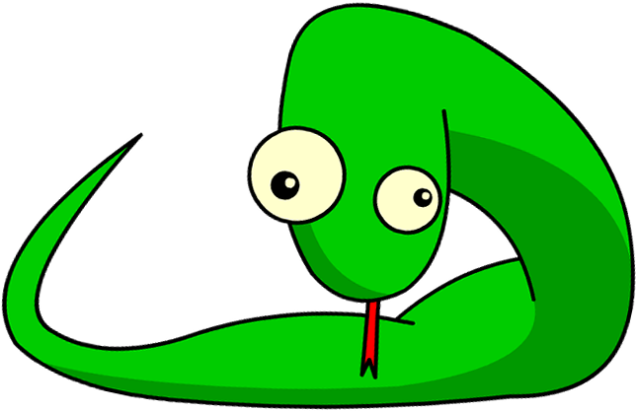
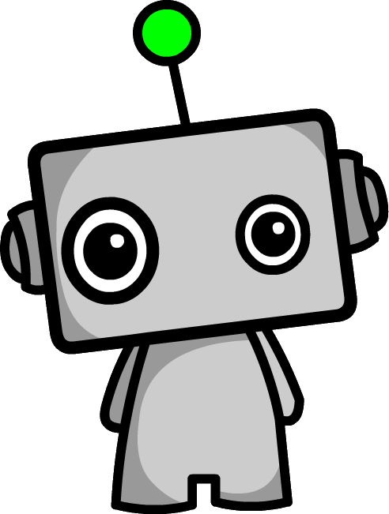
Introduction to Python Programming
Part 2: Using Variables

Slide 2
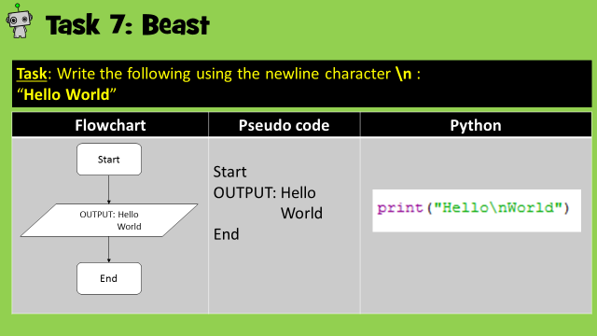
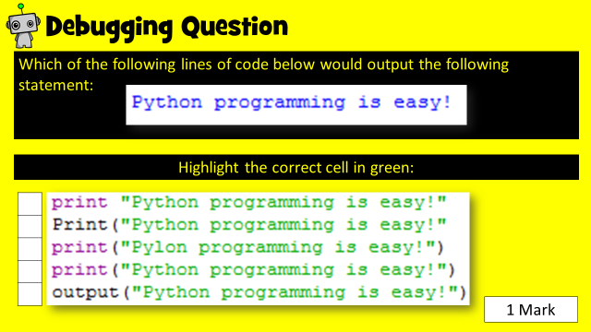
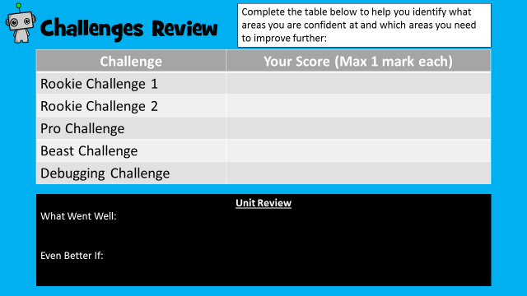
How to use this resource
Within each unit, you will learn how to develop and apply a range of Python programming skills. Skill explanations are in pink.
After reading the explanation of a skill, apply it within the given tasks. The tasks are categorised into Rookie (Easy), Pro (Medium) or Beast (Hard).
Once you have learned how to apply your new skills, demonstrate your ability by completing the given challenges. Don’t forget the debugging task!
Once complete, review your performance!
Skill Explanations: Pink Slides
Tasks: Rookie Pro Beast
Challenges: Rookie Pro Beast

Slide 3
Learning Objectives
Rookie
To assign data to a variable.
To be able to output a variable as part of a outputted statement.
Pro
To allow a user to input the contents of a variable.
To change the data stored within a variable.
Personalise outputted statements through user input.
Beast
To combine variables within an outputted statement.
Make calculations using variables.
To create new data by manipulating data from existing variables.

Slide 4
Skill Contents
Once you complete a skill, colour code the box to show your level of confidence. You can always revisit the skill later on to boost your confidence.
Contents | Confidence Level
Naming variables
Assigning data to a variable
Combining variables
Combining variables and string with print statements
Using the string conversion function str( )
Using the input function
Using the integer conversion function int( )
Checking the length of data within a variable len( )
Key | Colour Code
I am very good at this skill and could show a friend how to do it.
I am confident I can perform this skill on my own.
I need to improve my understanding of this skill.

Slide 5
What are Variables?
In programming, a variable can be described as a named storage location for data.
For example, the variable A could hold the value 6, David, Elephant, a calculation, another variable (or more!), or… pretty much anything you want!
As such, using variables requires a similar understanding to creating algebra expressions.
An important part of creating variables is to use memorable names so we can remember what information they hold and retrieve it later on.
Variable Rules
A variable name cannot start with a number
A variable name must not contain any spaces

Slide 6
Task 1: Name the Variables
Within the table below, think of suitable variable names to store the following information:
Information to be stored | Suitable variable name
The value of a dice roll
The number of points collected in a computer game
A computer game player’s name
The date of birth of a programme user
A quiz answer
Variable Rules
A variable name cannot start with a number
A variable name must not contain any spaces

Slide 7
Skill 1: Assigning data to a variable and printing it
Once data has been assigned to a variable, it can then be printed
You write it like this:
Allocate string to a variable
Print the variable
Allocating an integer to a variable
Print the variable
Notes | When adding string, always use quotation marks. Note that you don’t use quotation marks for printing a variable.

Slide 8
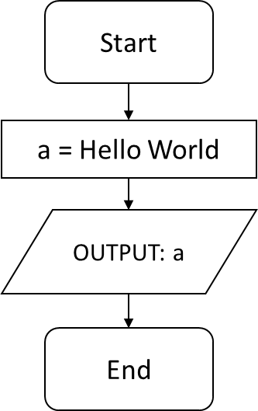
Task 2: Rookie
Create a variable called a.
Store the phrase Hello World within it.
Print a.
Flowchart | Pseudo code | Python
 | START a = Hello World OUTPUT: a END

Slide 9
Task 2: Solution
Add a print screen to show your coding here.
Add a print screen to show your output solution here.

Slide 10
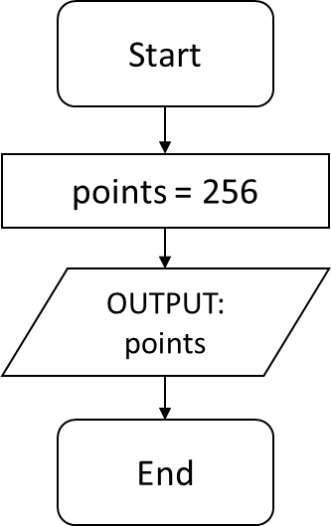
Task 3: Rookie
Create a variable called points.
Store the integer 256 in it.
Print points.
Flowchart | Pseudo code | Python
 | START points = 256 OUTPUT: points END

Slide 11
Task 3: Solution
Add a print screen to show your coding here.
Add a print screen to show your output solution here.

Slide 12
Skill 2: Combining variables and string in print statements
Variables can be combined with string statements.
This is very useful when it comes to printing out information.
The + Symbol
Using the + symbol as shown below allows you to join together (concatenate) data and information.
Allocate data to a variable
Print the variable within a sentence
Output
Notes | In the example, notice how spaces have been created within the text so that the variable is made to look part of it.

Slide 13
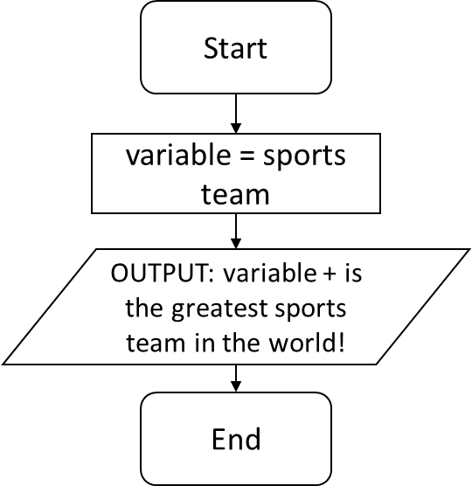
Task 4: Rookie
Create a variable and store the name of your favourite sports team.
Print it within the following statement: “[variable] is the greatest sports team in the world!”
Flowchart | Pseudo code | Python
 | START variable = sports team OUTPUT: variable + is the greatest sports team in the world! END

Slide 14
Task 4: Solution
Add a print screen to show your coding here.
Add a print screen to show your output solution here.

Slide 15
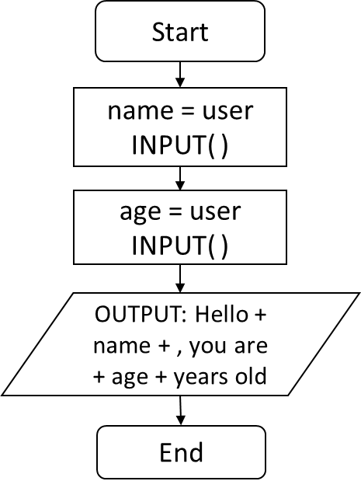
Task 5: Pro
str( ) function
You can convert integer numbers stored within a variable into string using this command.
Alternatively add the integer with a comer.
Create a variable and store your name in it.
Create a variable and store your age in it.
Print it within the following statement: “Hello[name], you are [age] years old”
Flowchart | Pseudo code | Python
 | START name = user INPUT( ) age = user INPUT( ) OUTPUT: Hello + name + , you are + age + years old END | Or

Slide 16
Task 5: Solution
Add a print screen to show your coding here.
Add a print screen to show your output solution here.

Slide 17
Skill 3: Allowing a user to input data into a variable
Creating programmes that interact with the user are great fun!
This is one way of doing this in Python!
input( ) function
The input ( ) function allows a user to input information into a programme. This information can then be stored using a variable.
Input information into a variable
Print the variable within a sentence
Output
Notes | Within the input( ) function, you can write a statement to tell the user what you want them to input.

Slide 18
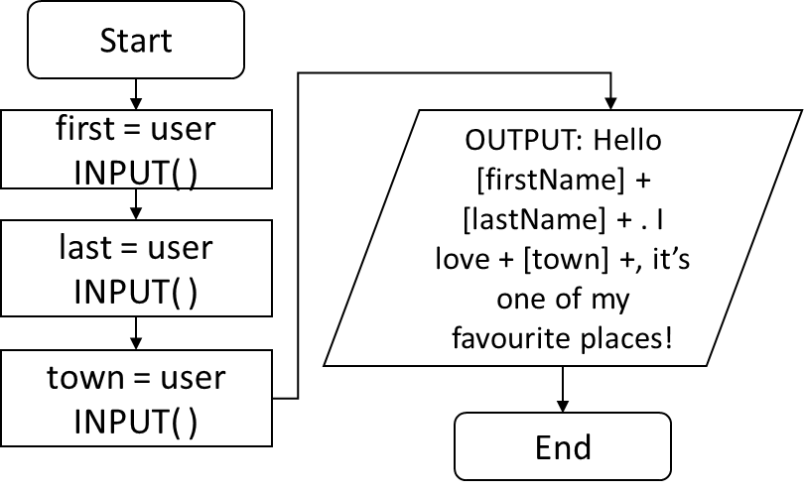
Task 6: Pro
Create suitable variables and ask the user to enter their first name, last name and town they live in.
Use the variables within the following output. “Hello [firstName] + [lastName] + . I love + [town] +, it’s one of my favourite places!”
Flowchart | Pseudo code
 | START first = user INPUT( ) last = user INPUT( ) town = user INPUT( ) OUTPUT: Hello [firstName] + [lastName] + ! I love + [town] +, it’s one of my favourite places! END

Slide 19
Task 6: Solution
Add a print screen to show your coding here.
Add a print screen to show your output solution here.

Slide 20
Skill 2: Combining variables
Variables can be combined together to create sentences.
This is very useful when it comes to printing out information.
The + Symbol
Using the + symbol as shown below allows you to join together (concatenate) variables.
Allocate data to the variables
Add a print statement
Output
Notes | In the example, notice how space in the praise variable makes the variables link within a smooth looking sentence.

Slide 21
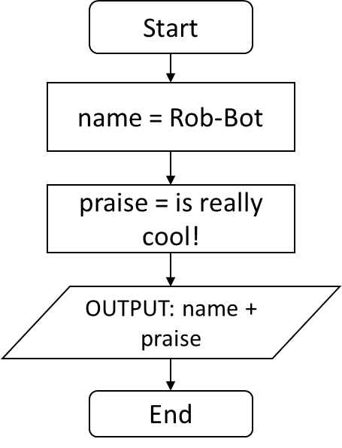
Task 7: Rookie
Create a variable and store your name in it.
In another variable store a positive comment.
Combine and output both variables.
Flowchart | Pseudo code | Python
 | START name = Rob-Bot praise = is really cool! OUTPUT: name + praise END

Slide 22
Task 7: Solution
Add a print screen to show your coding here.
Add a print screen to show your output solution here.

Slide 23
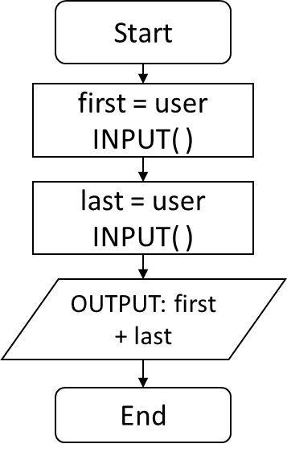
Task 8: Pro
Ask the user to input their first name. Store in a variable.
Ask the user to input their second name. Store in a variable.
Output both together.
Flowchart | Pseudo code | Python
 | START first = user INPUT( ) last = user INPUT( ) OUTPUT: first + last END

Slide 24
Task 8: Solution
Add a print screen to show your coding here.
Add a print screen to show your output solution here.

Slide 25
Skill 4: Converting user input into an integer
There are three main methods of converting user input into an integer:
int( ) function
When a user inputs information, python converts it to string by default. The information can be changed to an integer using the int( ) function.
Method 1: Convert input to integers in a separate variable
Method 2: Immediately convert user input into integers
Method 3: Convert input into integers within print

Slide 26
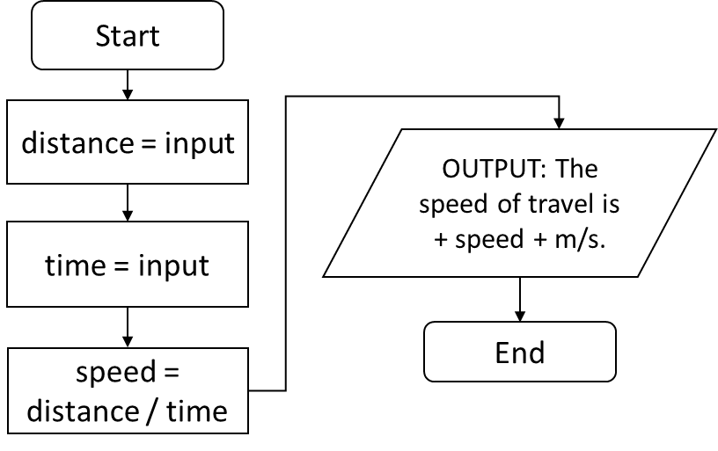
Task 9: Pro
Create a programme which calculates speed (m/s) from the distance and time inputted by a user.
Output the result within a suitable statement.
Flowchart | Pseudo code
 | START distance = user INPUT( ) time = user INPUT( ) speed = distance / time OUTPUT: The speed of travel is + speed + m/s. END

Slide 27
Task 9: Solution
Add a print screen to show your coding here.
Add a print screen to show your output solution here.

Slide 28
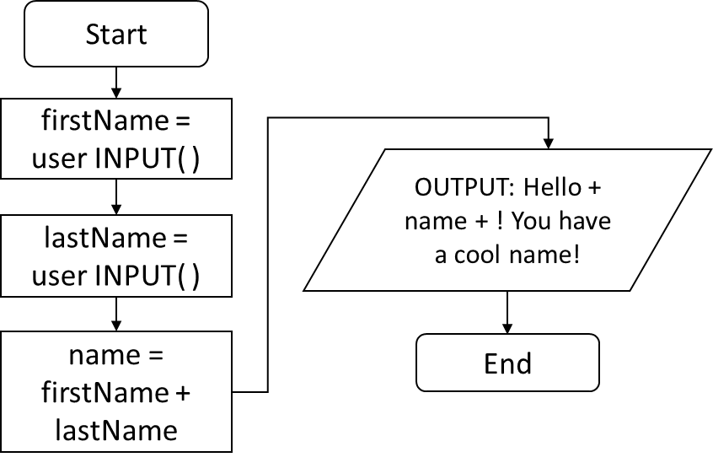
Task 10: Pro
Create a programme that asks for a user’s first name and last name and stores them in separate variables.
Combine them within another variable.
Output the final variable in an appropriate sentence.
Flowchart | Pseudo code
 | START firstName = user INPUT( ) lastName = user INPUT( ) name = firstName + lastName OUTPUT: Hello + name + ! You have a cool name! END

Slide 29
Task 10: Solution
Add a print screen to show your coding here.
Add a print screen to show your output solution here.

Slide 30
Skill 5: Checking the length of a string
len( ) function
The len( ) function measures the number of characters within a variable.
Python has some really useful functions.
This skill will show you how to measure the length of a string.
Input information into a variable
Check the length of the input string and store it.
Output the information
Notes | Note the use of + to join the string and , to join the integer.

Slide 31
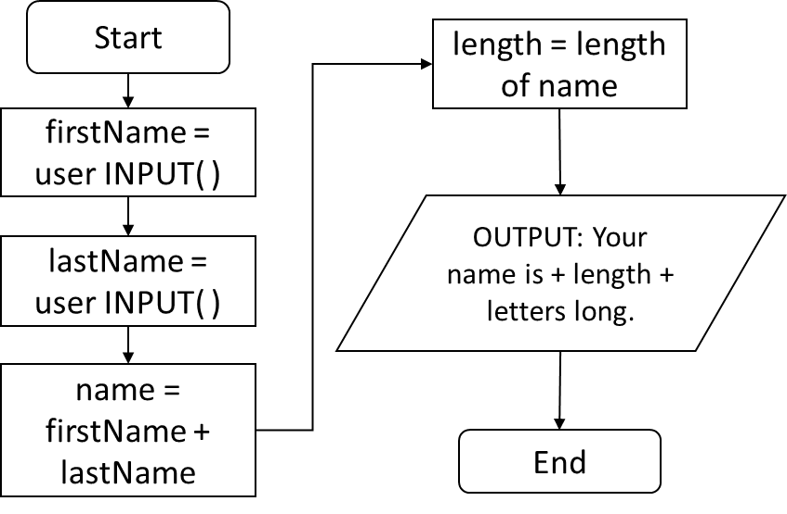
Task 11: Beast
Create a programme that asks for a user’s first name and last name and stores them in separate variables.
Combine them within another variable.
Calculate the length of the user’s name and output it within a suitable sentence.
Flowchart | Pseudo code
 | START firstName = input lastName = input name = firstName + lastName length = length of name OUTPUT: Your name is + length + letters long. END

Slide 32
Task 11: Solution
Add a print screen to show your coding here.
Add a print screen to show your output solution here.

Slide 33
Programming Challenges
Now you have learned some programming skills, it’s time to put them into practice!
Complete the following programming challenges. Start with the Rookie challenge and see how far you can push yourself.
Finally, complete the debugging challenge.
Once you have finished your challenges, complete the review. Look back at the skills you have learned so far to help you solve the challenge.

Slide 34
Programming Challenge: Rookie
Add a print screen of your solutions to the next slide.
Write a piece of code that asks a user to input their name then outputs a welcoming message which includes the user’s input like in the example below:
1 Mark

Slide 35
Programming Challenge: Rookie - Answer
Add a print screen to show your coding here.
Add a print screen to show your output solution here.

Slide 36
Programming Challenge: Pro
Add a print screen of your solutions to the next slide.
Write a piece of code that asks for the user’s year of birth and calculates what their age will be in the year 2050.
See the example below:
1 Mark

Slide 37
Programming Challenge: Pro - Answer
Add a print screen to show your coding here.
Add a print screen to show your output solution here.

Slide 38
Programming Challenge: Beast
Add a print screen of your solutions to the next slide.
Write a programme which asks a user five questions about themselves and outputs their answers within a string statement.
An example is included below:
1 Mark

Slide 39
Programming Challenge: Beast - Answer
Add a print screen to show your coding here.
Add a print screen to show your output solution here.

Slide 40
Debugging Question
Which of the following lines of code below would output the following statement:
Highlight the correct cell in green:
1 Mark

Slide 41
Challenges Review
Complete the table below to help you identify what areas you are confident at and which areas you need to improve further:
Challenge | Your Score (Max 1 mark each)
Rookie Challenge
Pro Challenge
Beast Challenge
Debugging Challenge
Unit Review
What Went Well:
Even Better If:

